Slide 1
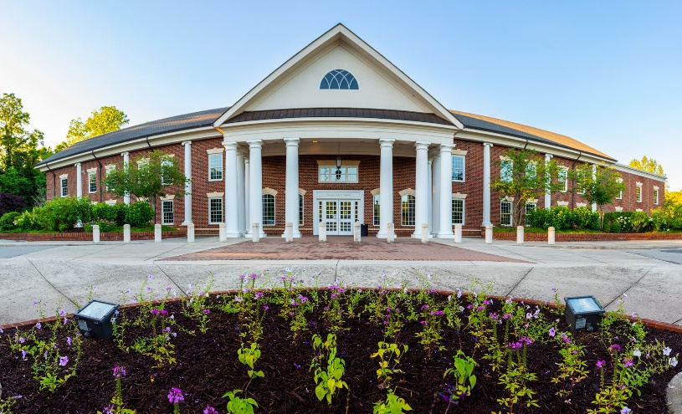
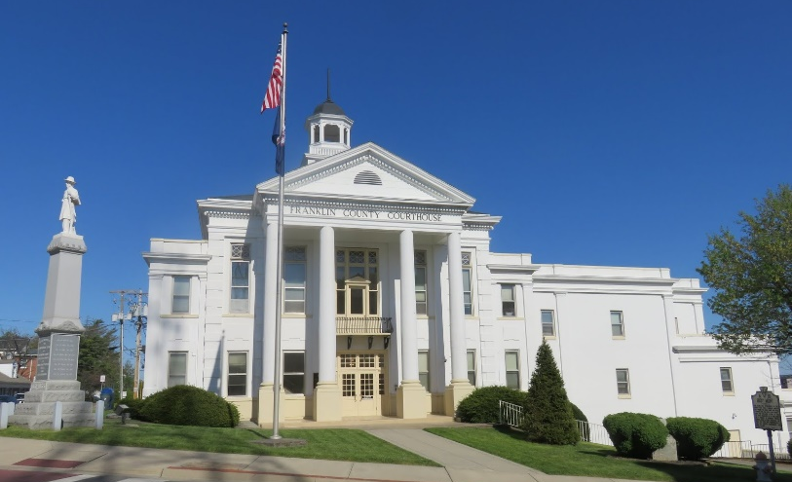
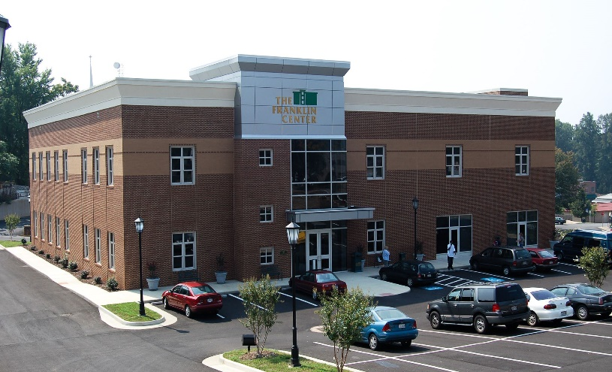
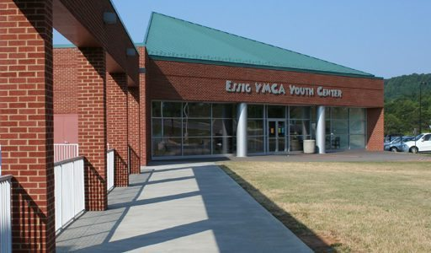
franklin County department of General properties
January 31, 2023

Slide 2
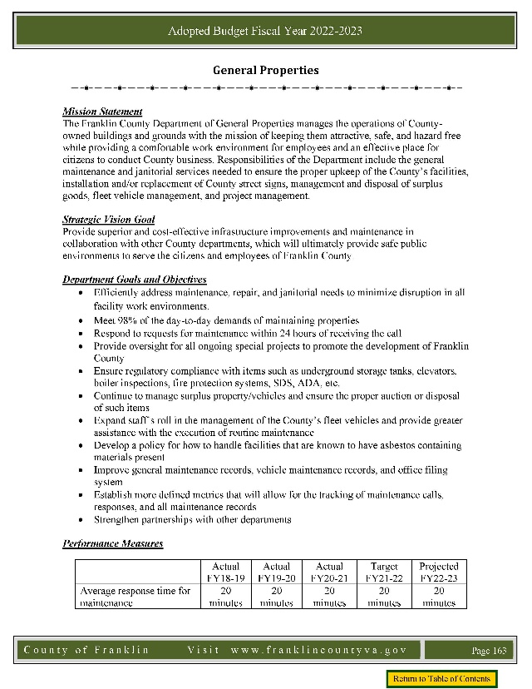
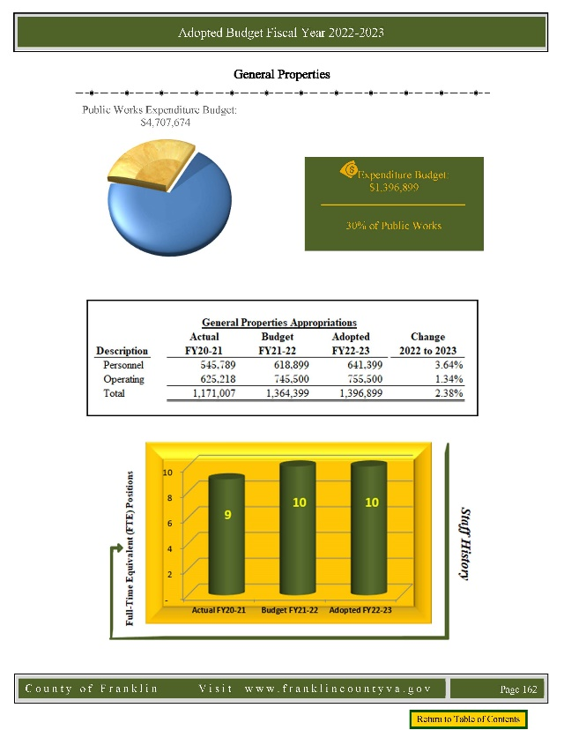

Operating Budget: FY 2023-2024
Increases in the Operating Budget for FY 2023-2024
Personnel Increases:
  Salary and Wages: $39,690
  Group Health Insurance: $40,904
Operations Requests:
  Repairs and Maintenance: $35,000
  Heating Services: $7,000
  Vehicle Fuel: $5,000

Slide 3
CIP: Recently Funded Projects
The Board of Supervisors generously approved funding for General Properties to complete the follow projects from the County’s fund balance:
Facilities Master Plan: $52,000
  Project is in process and scheduled to be completed in April 2023
  Includes the Courthouse, libraries, Public Safety, Sheriff’s Office, and Social Services
Replacement of Guardrail at Government Center: $35,000
  Should have under contract soon
  Price has increased to $40,300
Renovation of Waiting Area for Juvenile and Domestic Relations Courtroom #2: $7,500
  Waiting for door so that project can be completed
Facility Condition Assessment for Jail: $15,000
  Proposal received for $12,071
  Project timeline approximately 5 months

Slide 4
CIP Budget: FY 2023-2024
Requests for CIP Budget for FY 2023-2024
  General Properties Contingency $100,000
  Repairs/Renovations for Local Jail $150,000
  Elevator Modernization at Courthouse $132,000
  HVAC Replacements $100,000
  YMCA Facility $150,000
  Safety Upgrades $25,000
  General District Court Carpet Replacement $40,000
  Extension Office Exterior Painting $25,000

Slide 5
CIP Budget: FY 2023-2024
General Properties Contingency: $100,000
Used for projects that are outside of routine or scheduled maintenance
Project examples for this past year
  Replacement of 20 AED’s at various facilities
  Installation of Knox Boxes at various facilities
  AV upgrades in Administrative Conference Room
  Expansion of panic buttons in Registrar’s Office
  Assisting with jail repairs (ongoing)
  Upgrading of door locking software at Government Center
  Animal Shelter issues
  Renovation of 40 West Church Street for Piedmont Community Services
If funding is not replenished, General Properties will not be able to assist with projects such as these in the future.

Slide 6
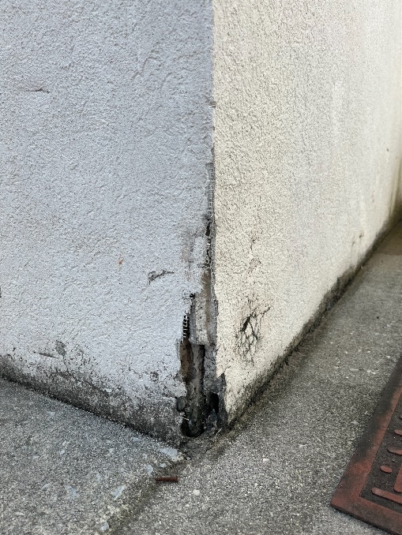
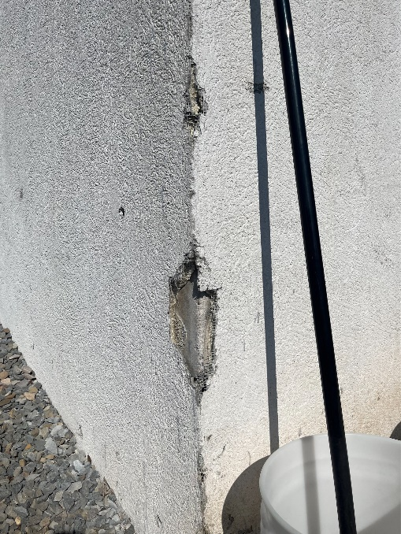
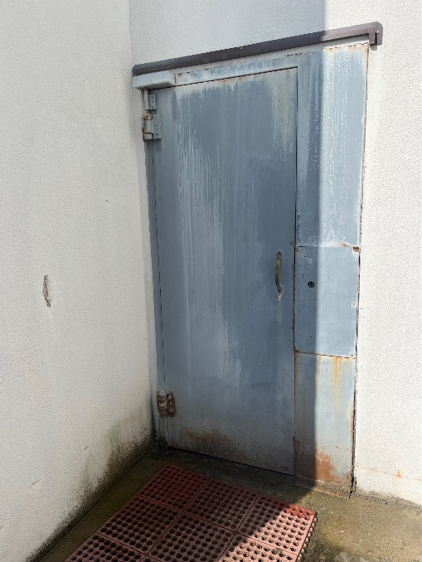
CIP Budget: FY 2023-2024
Repairs/Renovations for Local Jail: $150,000
Projects and prioritization will be based off of Facility Condition Assessment
Existing issues with exterior security doors, electrical system, plumbing system, broken windows, manual style gates, electronic door locking system, exterior insulation finishing system, boilers
Sheriff’s Office requesting funding for this as well

Slide 7
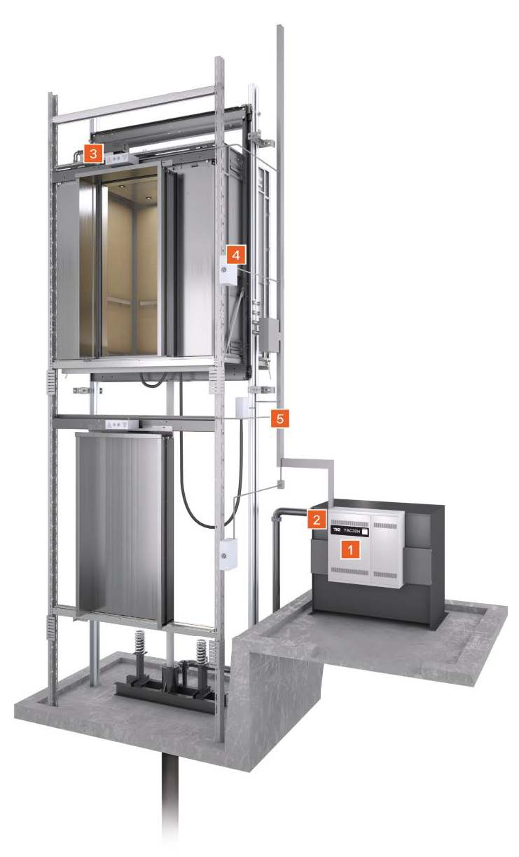
CIP Budget: FY 2023-2024
Elevator Modernization at Courthouse: $132,000
Two elevators at the Courthouse need modernization – replacement parts are obsolete and nearly impossible to find
Work would include replacement of:
  Controller
  Power Unit
  Universal Door Operator
  MOD Fusion Fixtures
  Wiring Package
Plan to modernize one unit at a time to avoid having two elevators down at once
Planned modernization it will allow us to improve safety and avoid the replacement of the entire system
Additional $132,000 will be requested for FY2024-2025 for second elevator

Slide 8
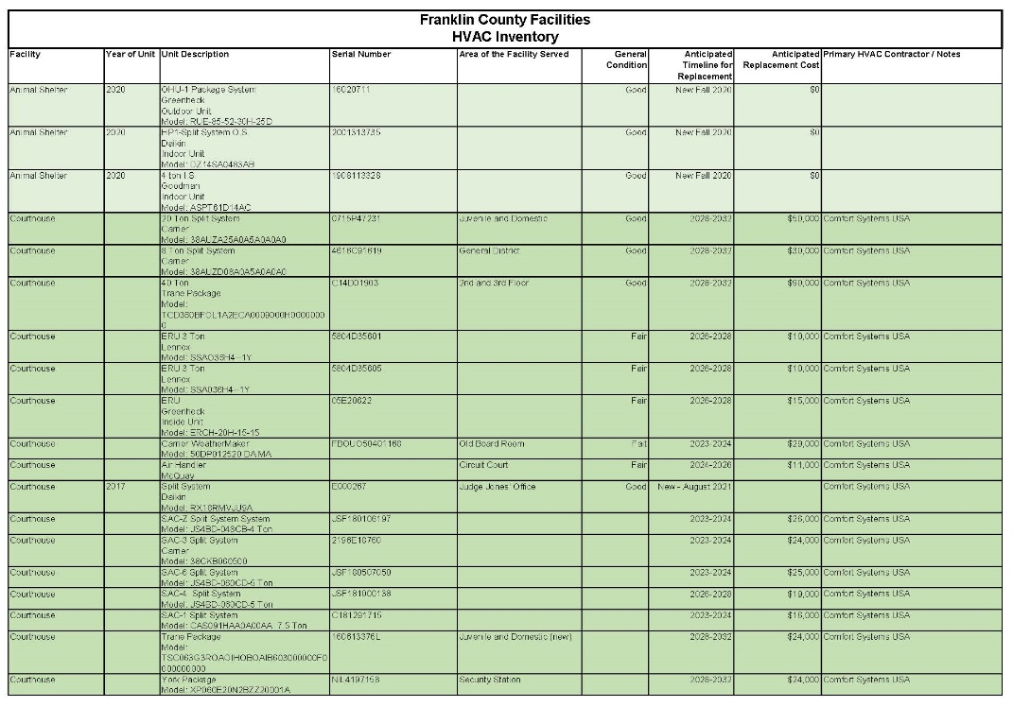
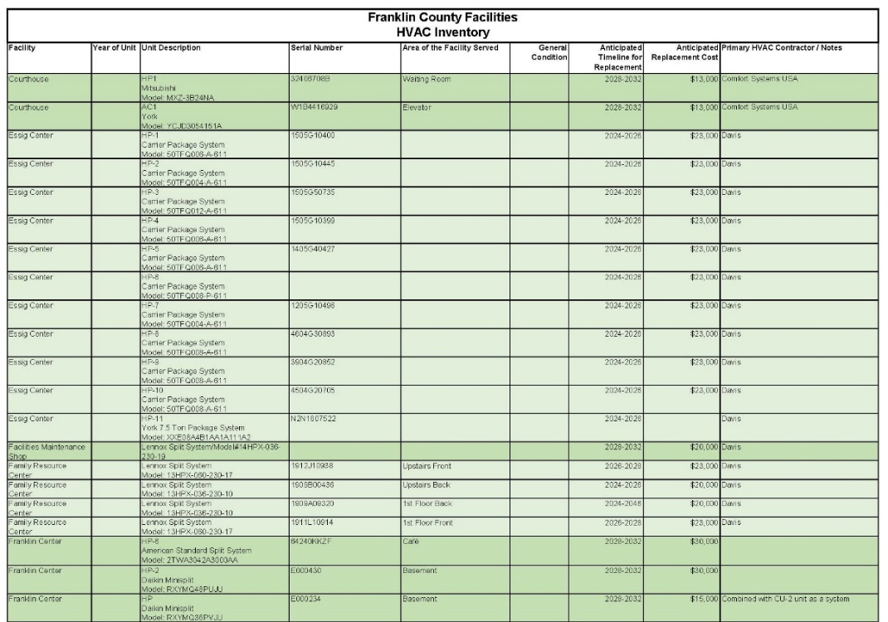
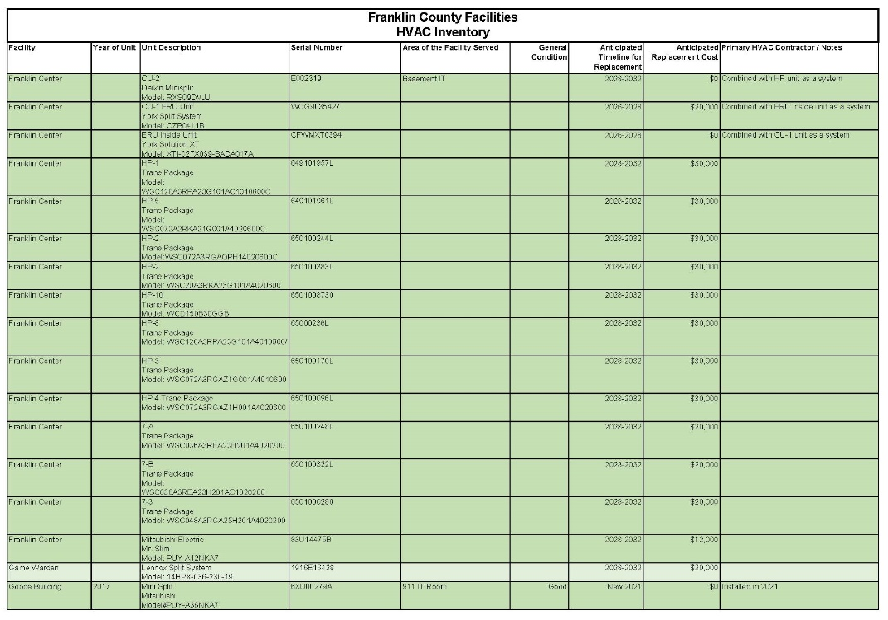
CIP Budget: FY 2023-2024
HVAC Replacements: $100,000
General Properties has an inventory of 103 HVAC units
Starting annual updates to estimate replacement timeline and associated costs
Age of units is starting to become an issue
  Spent over $52,000 on replacements since Christmas (parts and labor only)
Anticipated Replacements
  Now: $208,000
  1-3 Years: $447,000
  3-5 Years: $239,000
  5-10 Years: $1,490,000
  10+ Years: 17 units
  TOTAL: $2,384,000

Slide 9
CIP Budget: FY 2023-2024
YMCA Facility: $150,000
Physical needs assessment completed in 2017
The needs were broken down into three categories – immediate, short-term, and long-term
Immediate (1-2 years): $746,055
  Roof system, snow guards, roof drainage and roof edge fascia replacement at pool, patch and repair existing pavement, seal coat, and restriping, HVAC system (pool)
Short-Term (3-5 years): $224,550
  Door hardware, replace carpet and wall base, exterior control and opening sealant joints, payment overlay and restriping
Long-Term (6-10 years): $628,600
Total Estimated Cost (2017 dollars): $1,599,205

Slide 10
CIP Budget: FY 2023-2024
Safety Upgrades: $25,000
Would like to stop using contingency line item for safety upgrades
Potential upgrades include:
  Knox Boxes
  AEDs (planned replacement of batteries and units)
  Expansion of Panic Button System at various facilities
  Installation of Smoke Detectors
  Expansion of Door Locking Systems
  Assist with Camera Replacements
  Any safety issues identified by the Fire Marshal during annual inspections
Will work in conjunction with Safety Team

Slide 11
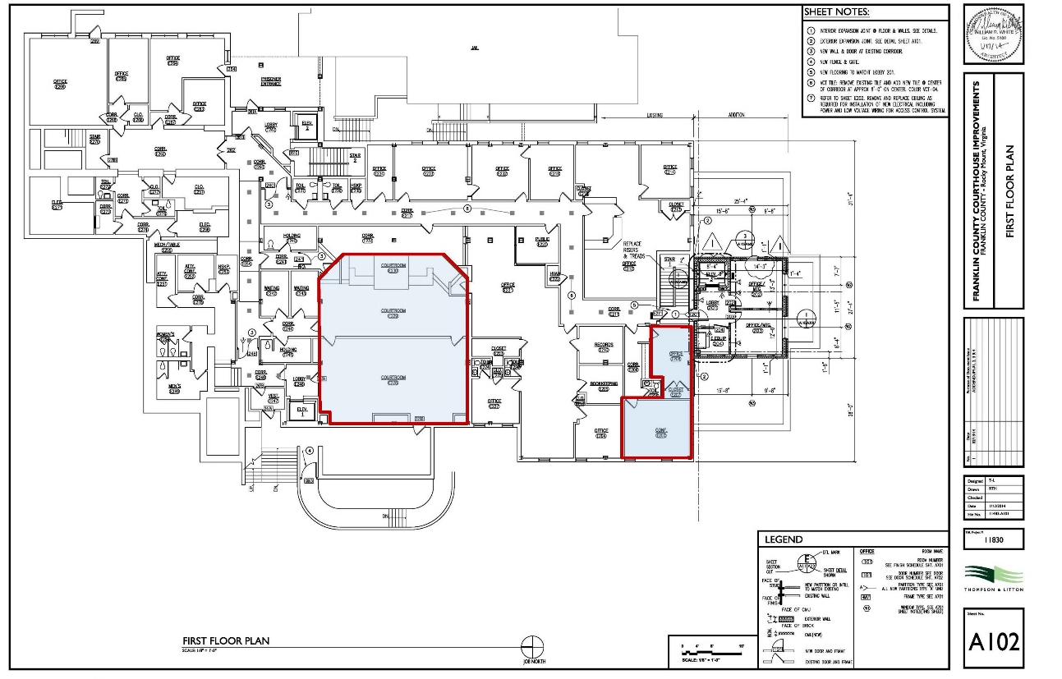
CIP Budget: FY 2023-2024
General District Court Carpet Replacement: $40,000
General District Court has requested the replacement of the carpet in their office, conference room, and courtroom
Quote has been received for $38,648

Slide 12
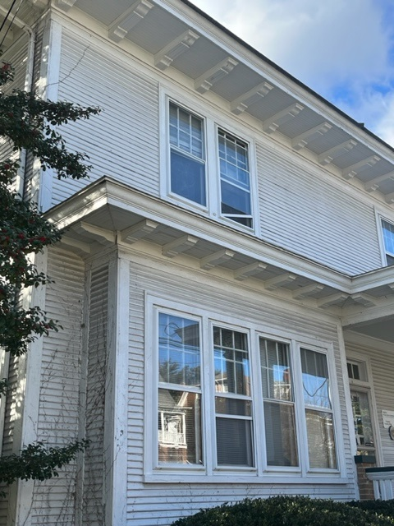
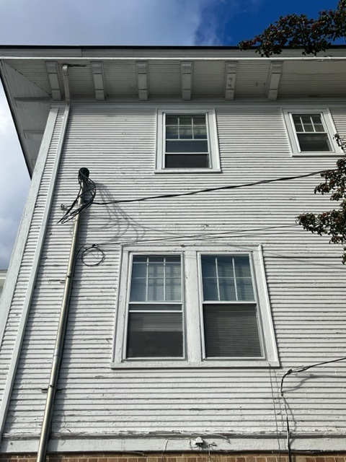
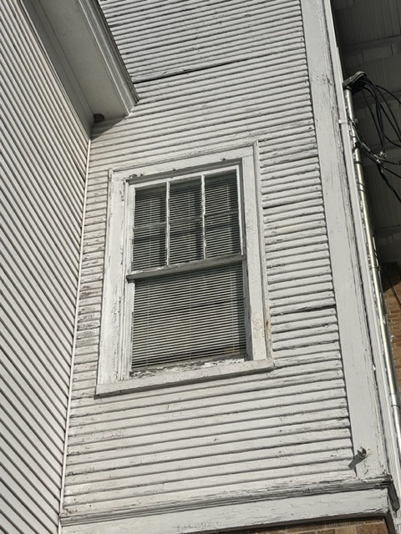
CIP Budget: FY 2023-2024
Extension Office Exterior Painting: $25,000

Slide 13
franklin County department of General properties
January 31, 2023

