Slide 1
GIS Department
Budget Requests
8114 - FY ‘24

Slide 2
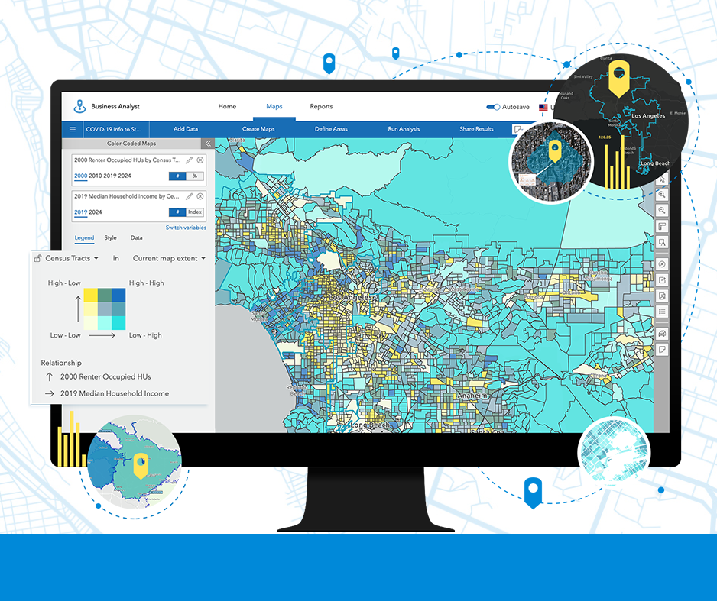
FY ‘24
GIS Department
$400 (Discounted for our SGEA)
- Esri’s Business Analyst -
5 Seats
2 Seats for Economic Dev.
1 Seat for County Admin
1 Seat for Tourism
1 Seat for GIS (Admin, etc.)
Uses
Demographics
Charts & Infographics
Raw Numbers & Analysis

Slide 3
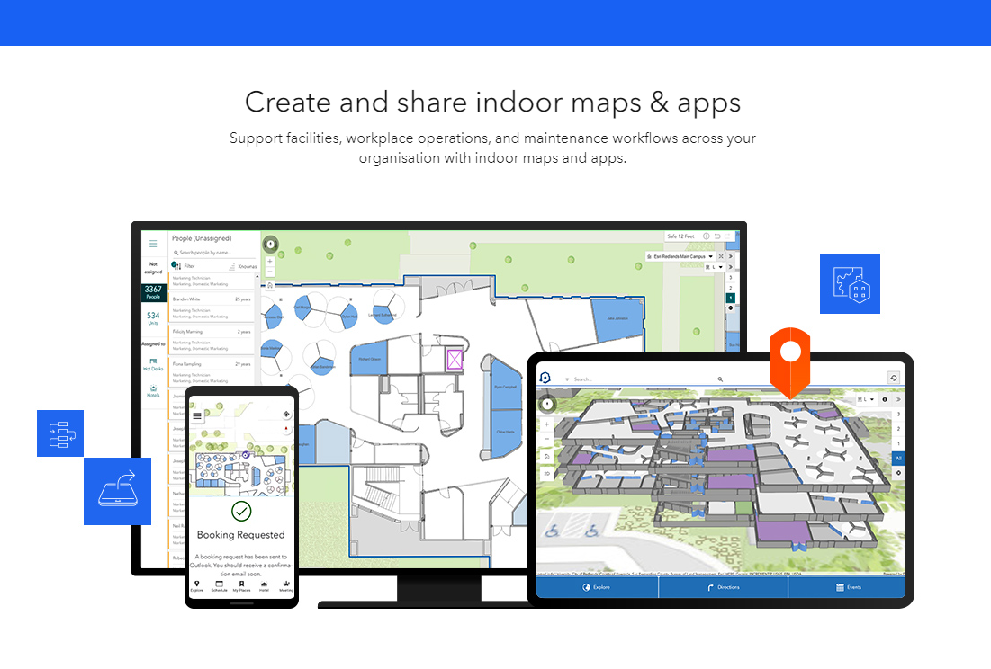
FY ‘24
GIS Department
$10,000 (Discounted for our SGEA)
- Esri’s Indoor Maps -
1 Site License
Users:
- General Properties (Property Mgt)
- Sheriff’s Office (9-1-1 & COP)
- Public Safety (Pre-Planning)
- IT (Asset Management)
- Schools (Safety & Space Allocation)
- GIS (Admin & Data Management)

Slide 4
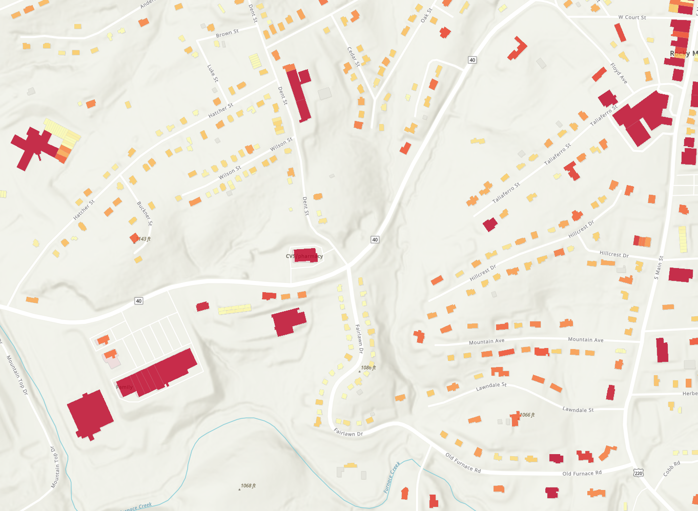
FY ‘24
GIS Department
One CIP Item
$12,747 (One-time expense)
- Updated Building Footprints -
Part of VGIN Data Buy-Up Program
Uses:
Change detection for assessment
Community Development (Multi Uses)
Site Selection & Viewshed Analysis
Structure Counts & Bldg Types
Identifying At-Risk Structures
Critical Building Preservation

Slide 5
FY ’24 - GIS Department
$61,834 ($35,000 Annual Salary)
- One FTE: GIS Technician -
Typical Duties:
  Parcel Maintenance (ca 800 hours/year)
  Address assignments (ca 100 hours/year)
  Coincident edits with parcel edits
  Weekly & monthly maintenance & public data updates
  Regular custom data requests
  Ad-hoc cartographic requests
  Assistance with larger project request
  At least 4,000 hours of backlogged data updates from neglect (’93 - ’18) and increased demand (‘18 – Present)
Benefits to Consider
  Pay for a $35K/Yr FTE and get the benefit freeing up existing GIS staff for far higher level and much better uses than tech work.
  Richer support of multiple County functions and priorities, such as:
    Public Safety & Law Enforcement
    Our Legislative Agenda
    Expanded Broadband Coverage
    Social & Community Services
    Environmental & Agricultural Concerns
    Planning & Zoning – Building
    Education & Training
    Public Works & General Properties
    Constitutional Offices
    VDH & VDoT
    Franklin County General Public

