Slide 1

Parks, Recreation
& Aging Services

Slide 2
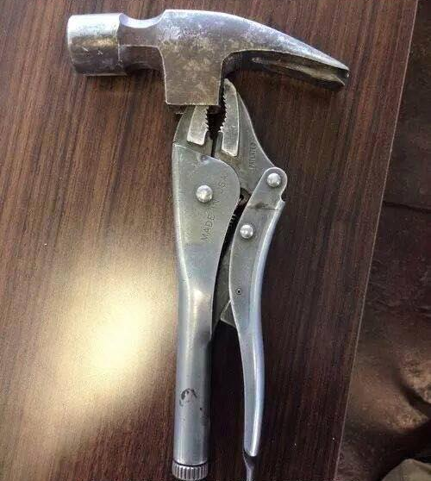
Versatile and Provide a Wide Range of Service

Slide 3
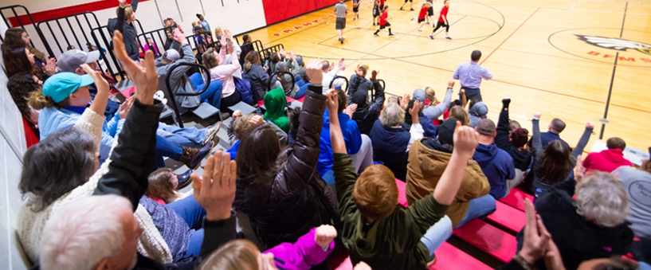
Full Return from COVID

Slide 4
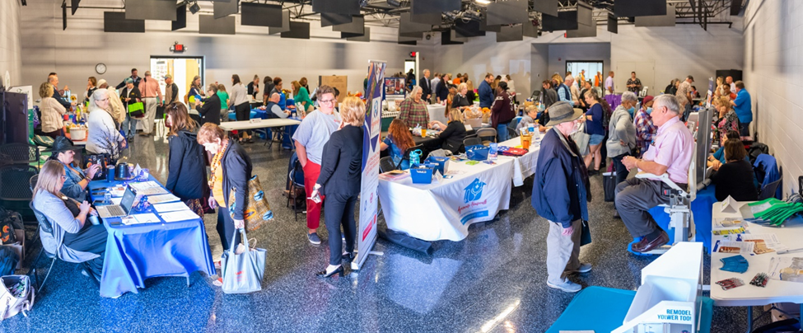
Growth in Aging Services

Slide 5
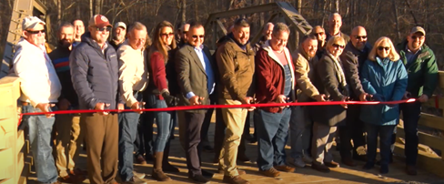
Increased Need for Maintenance

Slide 6
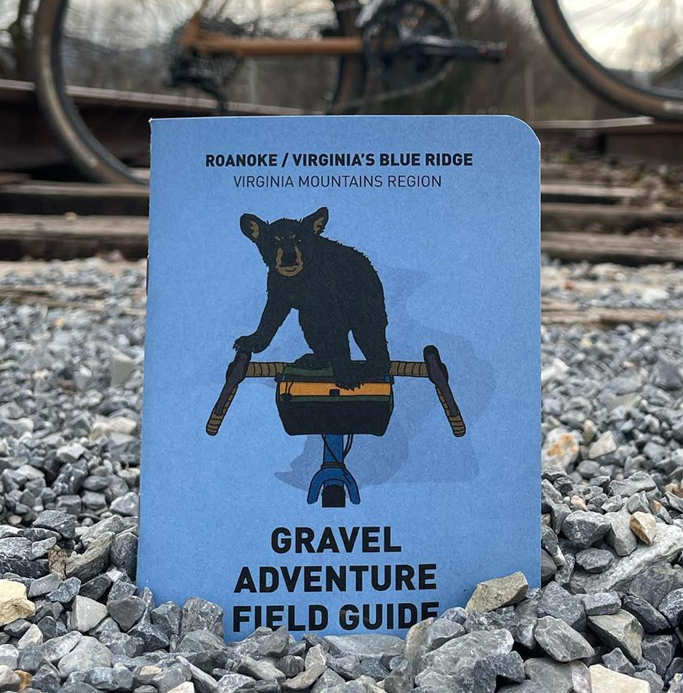
Support Destination
Marketing

Slide 7
Operational Budget Requests
Inflation - 8% added to:
Fuel
Electricity
Maintenance and Office Supplies
Uniforms
Contracted Maintenance

Slide 8
Operational Budget Requests
Training and Safety
Lifeguard Certification: $2,000
OSHA and VRPS Travel and Training: $4,500

Slide 9
Operational Budget Requests
Service Demands
Aging Services Outreach: $3,000
Aging Services Specific Marketing: $1,000
Advertising: $7,000
Outdoor Recreation: $16,000
Athletics/Aquatics/LOL: $21,000
Community Recreation: $4,830

Slide 10
Capital Budget Requests
Capital Maintenance - $340,000
SML Beach Security Cameras: $20,000
Recreation Park Multi-Use Shelter Renovation - Replace Roof and Lighting: $60,000
Skate Park Rehab 2/2 - Replace degraded equipment: $30,000
Jamison Mill Dredging: $40,000
Jamison Mill Asphalt Resurfacing: $50,000
LARC Landscaping: $15,000
Lions Field Dug Out and Seating Replacement: $15,000
Waid Park Commodity Bins: $10,000
Recreational Parking Lot Renovation: $100,000
SML Beach Renovation $100,000

Slide 11
Capital Budget Requests
Playground Repair, Replacement and Construction - $50,000
Lynch Park Playground Renovation

Slide 12
Capital Budget Requests
Park Development and Expansion – $80,000
Waid Park Campground Planning - Develop a conceptual plan for a public campground: $25,000
Snow Creek Park Planning - Develop a conceptual planning for improving Snow Creek Park: $15,000
Jamison Mill Campground Improvement - Update and expand utilities to campground sites: $40,000

Slide 13
Capital Budget Requests
Trails and Blueways - $50,000
Multiple blueway and greenway projects

Slide 14
Capital Budget Requests
Smith Mountain Lake Community Park - $50,000
Shoreline Maintenance

Slide 15
Capital Budget Requests
Smith Farm Development - $100,000
Development of the Smith Farm into a public park.

Slide 16
Capital Budget Requests
Equipment Replacement - $38,000
Replace two UTVs

Slide 17
Capital Budget Requests
Vehicle Replacement - $40,000
Replace 2009 E350 (179,000+)

Slide 18
Position Requests
Outdoor Recreation Maintenance Specialist
Athletic Specialist

Slide 19
Questions?

Slide 21
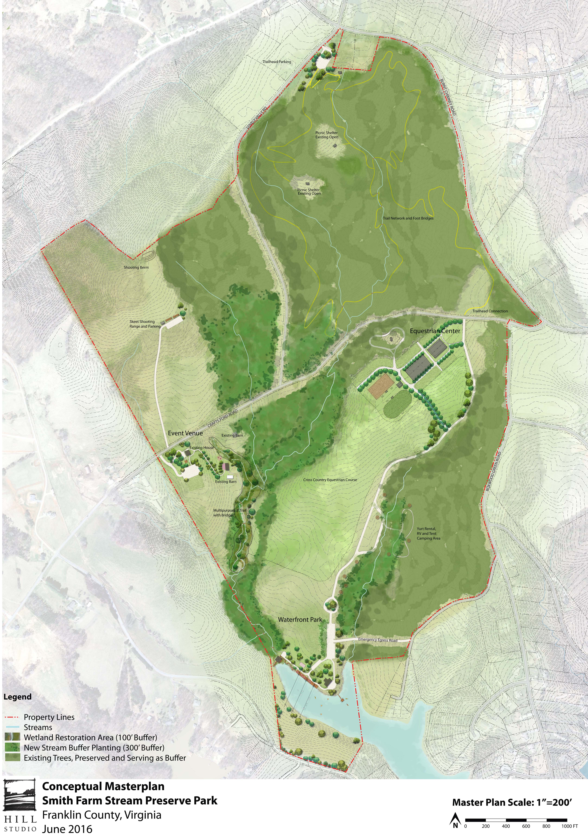

Slide 22
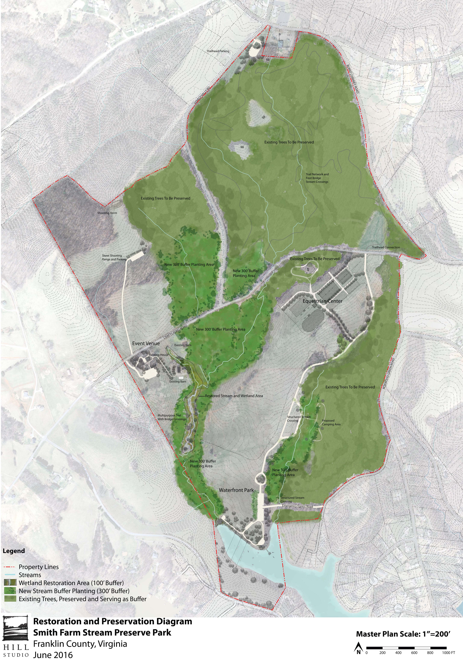

Slide 23
