Slide 1
FY 23 Public Safety BOS Budget Work Session
January 17, 2023
Franklin County’s Department of Public Safety is dedicated to providing Emergency services, to include, but not limited to, fire, emergency medical services, animal control and emergency management that are delivered in a timely and efficient manner by well-trained and dedicated career and volunteer professionals.

Slide 2
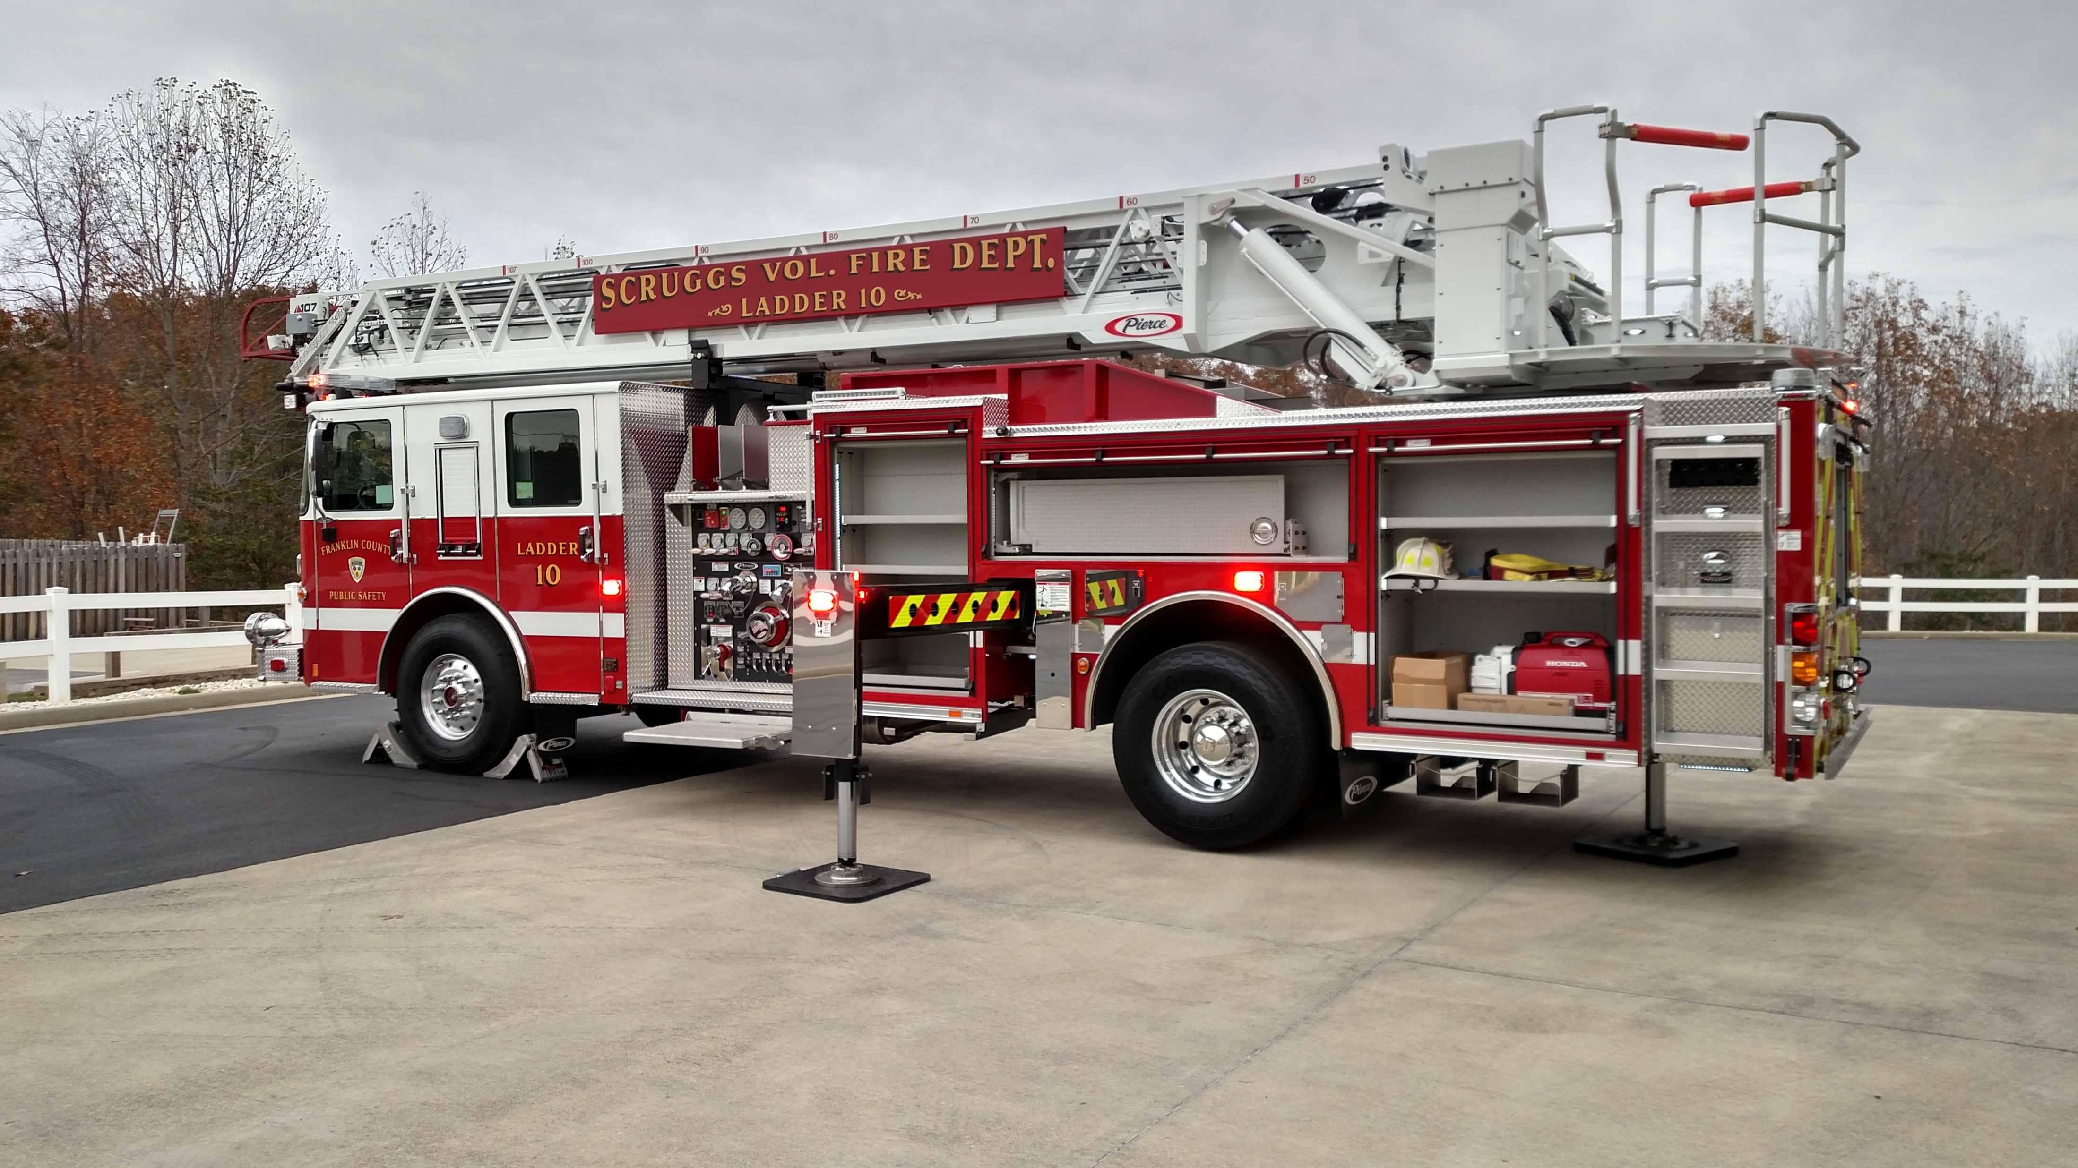
Work Session Topics
Review Of Previous Work Session
Apparatus Replacement Formula
Apparatus Maintenance
Volunteer Grant Program
FY 23-24 Budget Work Session
Capital Budget
Operating Budget
Potential Revenue

Slide 3

Thank You For Support In 22/23 Budget
6 New Positions – Lt. And 3 Field Providers!
Salary Increases And Adjustments!
New Vehicles – Captains, Communications!
New Fire Truck Purchase For Ferrum VFD!
$100K In Reserve For Radios!
Adjustment In Vacation Accrual!
SCBA Fill Station For Burnt Chimney VFD!
Two (2) New Cardiac Monitors!
Water/Septic & Restroom At Ferrum Training Facility!

Slide 4
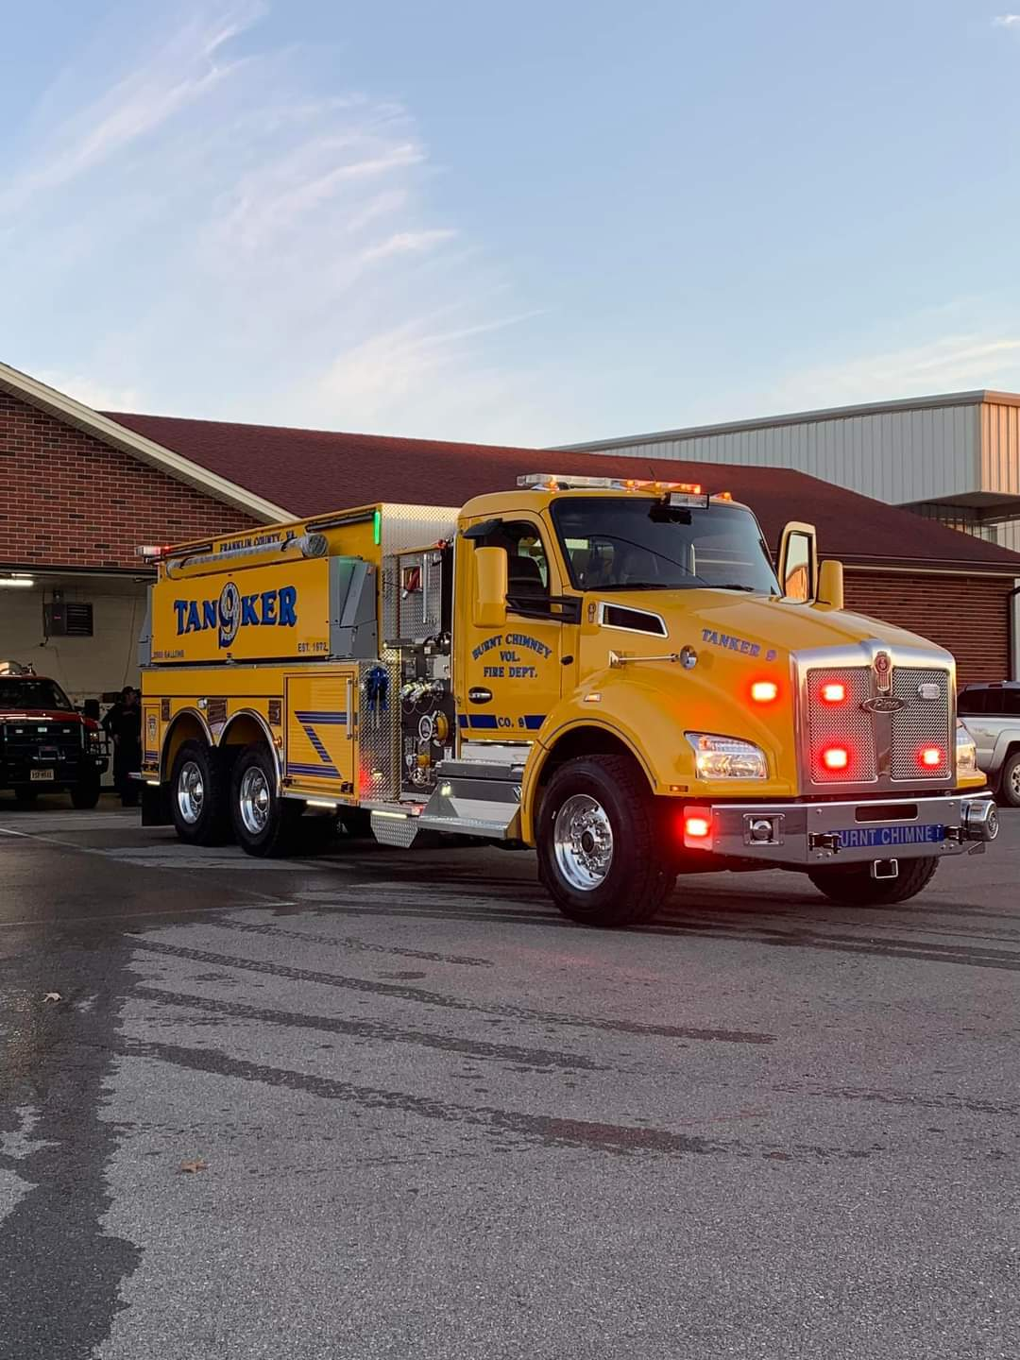
Fire Apparatus Replacement Program
Current Process For Apparatus Replacement Since Mid-90’s Is For Chief’s To Discuss And Decide Next Apparatus In Rotation
Summer 2022, BOS Asked Staff To Explore A “Formula” Based Replacement Program
A Review Committee Comprised Of James Allen Richards, Riley Peters, Morris Ledbetter, & Chief Of Department Being Evaluated
All Fire Apparatus Were Reviewed And Graded By Committee In September 2022
Notes:
Current Process Been In Place Since Mid 90’s. West Haven, Andover, Lincoln Formula Very Similar To One We Reviewed.

Slide 5
Current Fire Apparatus Rotation
FY-18/19 Engine 8, Tower 7, Ladder 10 In Service
FY-19/20 Brush 3 (Ferrum VFD) In Service
FY- 20/21 Tanker 6 (Snow Creek VFD) In Service
FY-21/22 Tanker 9 (Burnt Chimney VFD) Delivered
FY-22/23 Engine 3 (Ferrum VFD) In Service
FY-23/24 Tanker 5 (Callaway VFD) Recommend Ordering
FY-24/25 Tanker 7 (Boones Mill VFD)
FY-25/26 Tanker 10 (Scruggs VFD)
Notes:
Also Assisted With Additional Funding To Replace Attack 8 That Was Involved In A Crash

Slide 6
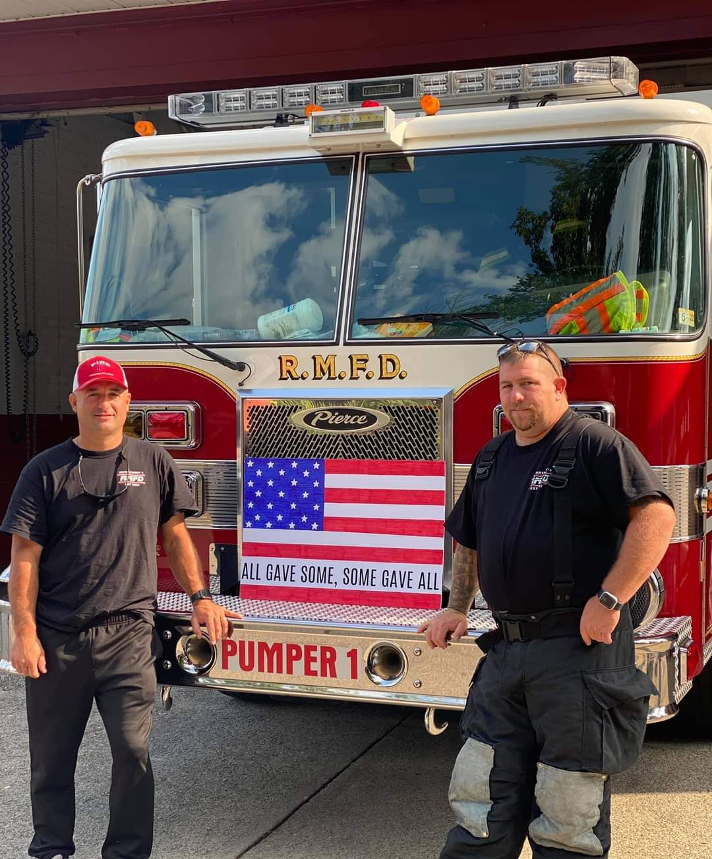
Fire Apparatus Replacement Program
The Following Criteria Was Utilized For Apparatus Inspection By The Committee:
Vehicle Type Engine Hours
Years In Service Maintenance/Repair Cost
Pump Size Vehicle Condition
Tank Size Reliability
Mileage Type Of Service

Slide 7
Vehicle Score Card:
Age | .075 point for every year of chronological age, based on in-service date.
Miles/Hours | One point for each 10,000 miles or 500 engine hours of use.
Type of Service | One, three, or five points are assigned based on the type of service the unit is exposed to. For example, fire pumpers would be given a five because it is classified as severe duty service. In contrast, an administrative sedan would be given a one.
Reliability | Points are assigned as one, three, or five depending on the frequency that a vehicle is in the shop for repair. A five would be assigned to a vehicle in the shop two or more times per month on average, while a one would be assigned to a vehicle in the shop an average of once every three months or less.
Maintenance and Repair costs | One to five points are assigned based on total life maintenance and repair (M&R) costs. A Five is assigned to a vehicle with life M&R costs equal to or greater than the vehicle’s original purchase price, while a one is given to a vehicle with life M&R costs equal to 20 percent or less than its original purchase cost.
Condition | This category takes into consideration body condition, rust, interior condition, accident history, and anticipated repairs. A scale of one to five points is used with five being poor condition.
Point Range | Less than 18, excellent; 18 to 22, good; 23 to 27, qualifies for replacement; and 28 and above means immediate replacement.

Slide 8
Fire Apparatus Replacement Program
Various Formula Methods Can Be Utilized
Initial Formula Considered Based On NFPA/IAFC Standards
Staff Has Gathered Information On Various Methods From Localities In Virginia & The Nation:
City Of Harrisonburg, VA
Henrico County, VA
West Haven, CT
Andover, KS
Lincoln, NB
Several Localities Utilize Similar Method Currently Used By Franklin County (Chief’s Ranking)
Several Localities Also Utilize Similar Methods As The NFPA/IAFC Method

Slide 9
Department | Unit # | Year | Mileage | Engine Hours | Vehicle Type | 2021 | 2022 | 2023 | 2024 | 2025 | 2026 | 2027 | 2028 | 2029 | 2030 | 2031 | 2032 | 2033 | 2034 | 2035 | 2036 | 2037 | 2038 | 2039 | 2040 | 2041
Ferrum Fire | Tanker 3 | 2016 | 7567 | 440 | Tanker | 13.4 | 14.3 | 15.3 | 16.2 | 17.2 | 18.1 | 19.1 | 20.0 | 20.9 | 21.9 | 22.8 | 23.8 | 24.7 | 25.7 | 26.6 | 27.6 | 28.5 | 29.5 | 30.4 | 31.3 | 32.3
Ferrum Fire | Brush 3 | 2019 | 4055 | 0 | Brush | 8.3 | 9.2 | 10.2 | 11.1 | 12.0 | 13.0 | 13.9 | 14.8 | 15.8 | 16.7 | 17.6 | 18.6 | 19.5 | 20.4 | 21.4 | 22.3 | 23.3 | 24.2 | 25.1 | 26.1 | 27.0
Ferrum Fire | Engine 3 | 2001 | 32414 | 2191 | Engine | 34.1 | 35.2 | 36.2 | 37.2 | 38.2 | 39.3 | 40.3 | 41.3 | 42.4 | 43.4 | 44.4 | 45.4 | 46.5 | 47.5 | 48.5 | 49.6 | 50.6 | 51.6 | 52.6 | 53.7 | 54.7
Ferrum Fire | Crash 3 | 1997 | 16986 | 0 | Crash | 35.5 | 36.3 | 37.1 | 37.9 | 38.7 | 39.5 | 40.3 | 41.1 | 41.9 | 42.7 | 43.5 | 44.3 | 45.1 | 45.9 | 46.7 | 47.5 | 48.3 | 49.1 | 49.9 | 50.7 | 51.5
Ferrum Fire | Engine 3A | 1998 | 29571 | 2421 | Engine | 36.8 | 37.9 | 38.9 | 39.9 | 40.9 | 41.9 | 43.0 | 44.0 | 45.0 | 46.0 | 47.0 | 48.1 | 49.1 | 50.1 | 51.1 | 52.1 | 53.1 | 54.2 | 55.2 | 56.2 | 57.2
Ferrum Fire | Unit 3 | 2001 | 166959 | 0 | Unit | 30.3 | 31.7 | 33.0 | 34.3 | 35.6 | 36.9 | 38.2 | 39.5 | 40.8 | 42.1 | 43.4 | 44.7 | 46.0 | 47.3 | 48.6 | 49.9 | 51.3 | 52.6 | 53.9 | 55.2 | 56.5
Glade Hill Fire | Utility 4 | 2012 | 12883 | 0 | Utility | 22.1 | 23.0 | 23.8 | 24.7 | 25.5 | 26.3 | 27.2 | 28.0 | 28.8 | 29.7 | 30.5 | 31.3 | 32.2 | 33.0 | 33.8 | 34.7 | 35.5 | 36.4 | 37.2 | 38.0 | 38.9
Scruggs Fire | Res Engine 4 | 1992 | 0 | 0 | Engine | 27.8 | 28.5 | 29.3 | 30.0 | 30.8 | 31.5 | 32.3 | 33.0 | 33.8 | 34.5 | 35.3 | 36.0 | 36.8 | 37.5 | 38.3 | 39.0 | 39.8 | 40.5 | 41.3 | 42.0 | 42.8
Glade Hill Fire | Tanker 4 | 1996 | 32312 | 1838 | Tanker | 39.2 | 40.1 | 41.1 | 42.0 | 42.9 | 43.9 | 44.8 | 45.7 | 46.7 | 47.6 | 48.6 | 49.5 | 50.4 | 51.4 | 52.3 | 53.3 | 54.2 | 55.1 | 56.1 | 57.0 | 57.9
Glade Hill Fire | Engine 4 | 2018 | 8047 | 552 | Engine | 15.1 | 16.2 | 17.3 | 18.5 | 19.6 | 20.7 | 21.8 | 22.9 | 24.0 | 25.2 | 26.3 | 27.4 | 28.5 | 29.6 | 30.8 | 31.9 | 33.0 | 34.1 | 35.2 | 36.3 | 37.5
Glade Hill Fire | Tanker 4B | 2010 | 16278 | 934 | Tanker | 23.9 | 24.8 | 25.8 | 26.7 | 27.7 | 28.7 | 29.6 | 30.6 | 31.5 | 32.5 | 33.4 | 34.4 | 35.4 | 36.3 | 37.3 | 38.2 | 39.2 | 40.1 | 41.1 | 42.1 | 43.0
Glade Hill Fire | Brush 4 | 2011 | 6247 | 0 | Brush | 20.6 | 21.4 | 22.1 | 22.9 | 23.7 | 24.5 | 25.3 | 26.1 | 26.9 | 27.7 | 28.4 | 29.2 | 30.0 | 30.8 | 31.6 | 32.4 | 33.2 | 34.0 | 34.7 | 35.5 | 36.3
Callaway Fire | Utility 5 | 1986 | 8139 | 0 | Utility | 15.5 | 16.3 | 17.0 | 17.8 | 18.6 | 19.4 | 20.2 | 21.0 | 21.8 | 22.6 | 23.4 | 24.2 | 25.0 | 25.8 | 26.5 | 27.3 | 28.1 | 28.9 | 29.7 | 30.5 | 31.3
Callaway Fire | Brush 5 | 2015 | 4344 | 0 | Brush | 15.5 | 16.3 | 17.0 | 17.8 | 18.6 | 19.4 | 20.2 | 21.0 | 21.8 | 22.6 | 23.4 | 24.2 | 25.0 | 25.8 | 26.5 | 27.3 | 28.1 | 28.9 | 29.7 | 30.5 | 31.3
Callaway Fire | Tanker 5 | 1992 | 30201 | 2106 | Tanker | 42.5 | 43.4 | 44.3 | 45.3 | 46.2 | 47.1 | 48.0 | 49.0 | 49.9 | 50.8 | 51.8 | 52.7 | 53.6 | 54.6 | 55.5 | 56.4 | 57.4 | 58.3 | 59.2 | 60.2 | 61.1
Callaway Fire | Tanker 5B | 1999 | 15996 | 908 | Tanker | 33.1 | 33.9 | 34.8 | 35.6 | 36.5 | 37.3 | 38.2 | 39.1 | 39.9 | 40.8 | 41.6 | 42.5 | 43.3 | 44.2 | 45.0 | 45.9 | 46.8 | 47.6 | 48.5 | 49.3 | 50.2
Callaway Fire | Attack 5 | 2016 | 6249 | 0 | Attack | 12.8 | 13.6 | 14.5 | 15.3 | 16.1 | 16.9 | 17.7 | 18.5 | 19.4 | 20.2 | 21.0 | 21.8 | 22.6 | 23.5 | 24.3 | 25.1 | 25.9 | 26.7 | 27.6 | 28.4 | 29.2
Callaway Fire | Engine 5 | 2009 | 9522 | 426 | Engine | 24.6 | 25.4 | 26.3 | 27.1 | 28.0 | 28.8 | 29.6 | 30.5 | 31.3 | 32.1 | 33.0 | 33.8 | 34.7 | 35.5 | 36.3 | 37.2 | 38.0 | 38.8 | 39.7 | 40.5 | 41.3
Snow Creek Fire | Engine 6 | 2008 | 16342 | 1081 | Engine | 22.7 | 23.6 | 24.6 | 25.5 | 26.5 | 27.4 | 28.4 | 29.4 | 30.3 | 31.3 | 32.2 | 33.2 | 34.1 | 35.1 | 36.0 | 37.0 | 38.0 | 38.9 | 39.9 | 40.8 | 41.8
Snow Creek Fire | Tanker 6 | 2003 | 16434 | 1059 | Tanker | 33.4 | 34.3 | 35.2 | 36.1 | 37.0 | 37.9 | 38.8 | 39.7 | 40.6 | 41.5 | 42.4 | 43.3 | 44.2 | 45.1 | 45.9 | 46.8 | 47.7 | 48.6 | 49.5 | 50.4 | 51.3
Snow Creek Fire | Tanker 6B | 2022 | 2537 | 0 | Tanker | 6.4 | 7.0 | 7.5 | 8.1 | 8.7 | 9.3 | 9.9 | 10.4 | 11.0 | 11.6 | 12.2 | 12.8 | 13.3 | 13.9 | 14.5 | 15.1 | 15.7 | 16.3 | 16.8 | 17.4 | 18.0
Snow Creek Fire | Brush 6 | 2011 | 7112 | 0 | Brush | 20.6 | 21.4 | 22.2 | 23.0 | 23.8 | 24.6 | 25.4 | 26.2 | 27.0 | 27.7 | 28.5 | 29.3 | 30.1 | 30.9 | 31.7 | 32.5 | 33.3 | 34.1 | 34.9 | 35.7 | 36.5
Boones Mill Fire | Tower 7 | 2019 | 4679 | 348 | Tower | 10.9 | 12.0 | 13.1 | 14.1 | 15.2 | 16.2 | 17.3 | 18.4 | 19.4 | 20.5 | 21.5 | 22.6 | 23.7 | 24.7 | 25.8 | 26.8 | 27.9 | 29.0 | 30.0 | 31.1 | 32.1
Boones Mill Fire | Tanker 7 | 1997 | 29688 | 2122 | Tanker | 38.0 | 39.0 | 39.9 | 40.9 | 41.9 | 42.9 | 43.9 | 44.8 | 45.8 | 46.8 | 47.8 | 48.7 | 49.7 | 50.7 | 51.7 | 52.6 | 53.6 | 54.6 | 55.6 | 56.5 | 57.5
Boones Mill Fire | Brush 7 | 2002 | 13717 | 0 | Brush | 29.7 | 30.5 | 31.3 | 32.1 | 32.9 | 33.7 | 34.5 | 35.3 | 36.1 | 36.8 | 37.6 | 38.4 | 39.2 | 40.0 | 40.8 | 41.6 | 42.4 | 43.2 | 44.0 | 44.8 | 45.6
Boones Mill Fire | Pumper 7 | 2002 | 23132 | 1156 | Pumper | 30.3 | 31.2 | 32.1 | 33.0 | 33.9 | 34.8 | 35.7 | 36.6 | 37.5 | 38.4 | 39.4 | 40.3 | 41.2 | 42.1 | 43.0 | 43.9 | 44.8 | 45.7 | 46.6 | 47.5 | 48.4
Boones Mill Fire | Engine 7 | 2014 | 14762 | 915 | Engine | 19.8 | 21.9 | 21.9 | 23.0 | 24.1 | 25.1 | 26.2 | 27.2 | 28.3 | 29.3 | 30.4 | 31.4 | 32.5 | 33.5 | 34.6 | 35.7 | 36.7 | 37.8 | 38.8 | 39.9 | 40.9
Boones Mill Fire | Rescue 7 | 2001 | 14137 | 0 | Rescue | 27.5 | 28.3 | 29.8 | 29.8 | 30.6 | 31.4 | 32.2 | 33.0 | 33.8 | 34.6 | 35.4 | 36.2 | 37.0 | 37.8 | 38.6 | 39.4 | 40.2 | 41.0 | 41.8 | 42.6 | 43.4
Boones Mill Fire | Utility 7 | 2004 | 151390 | 0 | Utility | 31.3 | 32.7 | 34.0 | 36.7 | 36.7 | 38.0 | 39.4 | 40.7 | 42.1 | 43.4 | 44.8 | 46.1 | 47.4 | 48.8 | 50.1 | 51.5 | 52.8 | 54.2 | 55.5 | 56.8 | 58.2
Henry Fire | Res Engine 8 | 1991 | 38072 | 0 | Engine | 30.4 | 31.2 | 32.1 | 32.9 | 33.7 | 34.6 | 35.4 | 36.2 | 37.1 | 37.9 | 38.7 | 39.6 | 40.4 | 41.3 | 42.1 | 42.9 | 43.8 | 44.6 | 45.4 | 46.3 | 47.1
Fork Mountain Fire | Engine 8 | 2019 | 6075 | 442 | Engine | 11.1 | 12.3 | 13.4 | 14.6 | 15.7 | 18.0 | 18.0 | 19.1 | 20.3 | 21.4 | 22.6 | 23.7 | 24.8 | 26.0 | 27.1 | 28.3 | 29.4 | 30.6 | 31.7 | 32.8 | 34.0
Fork Mountain Fire | Brush 8 | 2005 | 11206 | 0 | Brush | 19.3 | 20.1 | 20.9 | 21.7 | 22.5 | 23.3 | 24.9 | 24.9 | 25.7 | 26.5 | 27.2 | 28.0 | 28.8 | 29.6 | 30.4 | 31.2 | 32.0 | 32.8 | 33.6 | 34.4 | 35.2
Fork Mountain Fire | Tanker 8 | 2012 | 10758 | 834 | Tanker | 20.2 | 21.1 | 22.1 | 23.1 | 24.1 | 25.0 | 26.0 | 27.9 | 27.9 | 28.9 | 29.9 | 30.9 | 31.8 | 32.8 | 33.8 | 34.8 | 35.7 | 36.7 | 37.7 | 38.6 | 39.6
Burnt Chimney Fire | Engine 9 | 2014 | 17244 | 1335 | Engine | 16.7 | 17.9 | 19.1 | 20.3 | 21.5 | 22.6 | 23.8 | 25.0 | 27.4 | 27.4 | 28.6 | 29.8 | 31.0 | 32.2 | 33.4 | 34.6 | 35.8 | 37.0 | 38.2 | 39.4 | 40.6
Burnt Chimney Fire | Tanker 9 | 1999 | 37332 | 1561 | Tanker | 38.4 | 39.3 | 40.2 | 41.2 | 42.1 | 43.0 | 44.0 | 44.9 | 45.8 | 47.7 | 47.7 | 48.6 | 49.5 | 50.5 | 51.4 | 52.3 | 53.3 | 54.2 | 55.1 | 56.1 | 57.0
Burnt Chimney Fire | Attack 9 | 2004 | 20148 | 0 | Attack | 28.5 | 29.4 | 30.3 | 31.2 | 32.1 | 33.0 | 33.9 | 34.8 | 35.7 | 36.6 | 38.4 | 38.4 | 39.3 | 40.2 | 41.1 | 42.0 | 42.9 | 43.8 | 44.7 | 45.6 | 46.5
Burnt Chimney Fire | Brush 9 | 2010 | 9897 | 0 | Brush | 18.5 | 19.3 | 20.1 | 20.9 | 21.7 | 22.5 | 23.3 | 24.1 | 24.9 | 25.7 | 26.5 | 28.2 | 28.2 | 29.0 | 29.8 | 30.6 | 31.4 | 32.2 | 33.0 | 33.8 | 34.6
Scruggs Fire | Attack 10 | 2019 | 8390 | 505 | Attack | 11.3 | 12.5 | 13.7 | 14.9 | 16.1 | 17.3 | 18.5 | 19.7 | 20.9 | 22.1 | 23.2 | 24.4 | 26.8 | 26.8 | 28.0 | 29.2 | 30.4 | 31.6 | 32.8 | 34.0 | 35.2
Scruggs Fire | Mini Pumper 10 | 2001 | 16162 | 0 | Mini Pumper | 37.3 | 38.1 | 38.9 | 39.7 | 40.5 | 41.3 | 42.1 | 42.9 | 43.7 | 44.5 | 45.3 | 46.1 | 46.9 | 48.5 | 48.5 | 49.3 | 50.1 | 50.9 | 51.7 | 52.5 | 53.3
Scruggs Fire | Tanker 10 | 2003 | 21114 | 1164 | Tanker | 30.6 | 31.5 | 32.4 | 33.3 | 34.2 | 35.1 | 36.1 | 37.0 | 37.9 | 38.8 | 39.7 | 40.6 | 41.5 | 42.5 | 44.3 | 44.3 | 45.2 | 46.1 | 47.0 | 47.9 | 48.8
Scruggs Fire | Command 10 | 2021 | 12935 | 0 | Unit | 5.4 | 7.0 | 8.6 | 10.2 | 11.8 | 13.5 | 15.1 | 16.7 | 18.3 | 19.9 | 21.5 | 23.1 | 24.7 | 26.4 | 28.0 | 31.2 | 31.2 | 32.8 | 34.4 | 36.0 | 37.6
Scruggs Fire | Dive 10 | 1995 | 63518 | 0 | Dive | 26.7 | 27.6 | 28.5 | 29.4 | 30.3 | 31.2 | 32.2 | 33.1 | 34.0 | 34.9 | 35.8 | 36.7 | 37.6 | 38.5 | 39.5 | 40.4 | 42.2 | 42.2 | 43.1 | 44.0 | 44.9
Scruggs Fire | Ladder 10 | 2019 | 4513 | 398 | Ladder | 11.0 | 12.1 | 13.3 | 14.4 | 15.5 | 16.6 | 17.7 | 18.8 | 19.9 | 21.0 | 22.1 | 23.2 | 24.3 | 25.4 | 26.5 | 27.6 | 28.7 | 30.9 | 30.9 | 32.0 | 33.1
Scruggs Fire | Utility 10 | 2016 | 100842 | 0 | Utility | 21.8 | 25.3 | 28.7 | 32.2 | 35.6 | 39.0 | 42.5 | 45.9 | 49.3 | 52.8 | 56.2 | 59.7 | 63.1 | 66.5 | 70.0 | 73.4 | 76.9 | 80.3 | 87.2 | 87.2 | 90.6
Henry Fire | Brush 14 | 2015 | 4559 | 0 | Brush | 14.7 | 15.5 | 16.4 | 17.2 | 18.1 | 18.9 | 19.7 | 20.6 | 21.4 | 22.2 | 23.1 | 23.9 | 24.7 | 25.6 | 26.4 | 27.3 | 28.1 | 28.9 | 29.8 | 31.4 | 31.4
Henry Fire | Response 14 | 1999 | 123527 | N/A | Response | 37.1 | 38.6 | 40.2 | 41.7 | 43.2 | 44.8 | 46.3 | 47.8 | 49.4 | 50.9 | 52.4 | 54.0 | 55.5 | 57.0 | 58.6 | 60.1 | 61.7 | 63.2 | 64.7 | 66.3 | 67.8
Henry Fire | Engine 14 | 2001 | 18481 | 1427 | Engine | 36.6 | 37.5 | 38.5 | 39.4 | 40.3 | 41.3 | 42.2 | 43.1 | 44.1 | 45.0 | 45.9 | 46.8 | 47.8 | 48.7 | 49.6 | 50.6 | 51.5 | 52.4 | 53.4 | 54.3 | 55.2
Henry Fire | Tanker 14 | 2006 | 21454 | 1204 | Tanker | 26.4 | 27.4 | 28.3 | 29.3 | 30.2 | 31.2 | 32.1 | 33.1 | 34.0 | 35.0 | 35.9 | 36.9 | 37.8 | 38.8 | 39.7 | 40.7 | 41.6 | 42.6 | 43.5 | 44.5 | 45.4
Henry Fire | Crash 14 | 1999 | 1650 | 0 | Crash | 29.4 | 30.2 | 30.9 | 31.7 | 32.5 | 33.2 | 34.0 | 34.7 | 35.5 | 36.3 | 37.0 | 37.8 | 38.5 | 39.3 | 40.0 | 40.8 | 41.6 | 42.3 | 43.1 | 43.8 | 44.6
Weslake | Engine 15 | 2006 | 24991 | 0 | Engine | 20.5 | 21.4 | 22.2 | 23.1 | 23.9 | 24.8 | 25.7 | 26.5 | 27.4 | 28.2 | 29.1 | 30.0 | 30.8 | 31.7 | 32.6 | 33.4 | 34.3 | 35.1 | 36.0 | 36.9 | 37.7
Scruggs Fire | Unit 10* | 2020 | 0 | 0 | Unit | 3.8 | 4.5 | 5.3 | 6.0 | 6.8 | 7.5 | 8.3 | 9.0 | 9.8 | 10.5 | 11.3 | 12.0 | 12.8 | 13.5 | 14.3 | 15.0 | 15.8 | 16.5 | 17.3 | 18.0 | 18.8
Ferrum | Engine 3 | 2022 | 1,456 | 0 | Engine | 7.1 | 7.8 | 8.6 | 9.3 | 10.1 | 10.8 | 11.6 | 12.3 | 13.1 | 13.8 | 14.6 | 15.3 | 16.1 | 16.8 | 17.6 | 18.3 | 19.1 | 19.8 | 20.6 | 21.3 | 22.1
Snow Creek | T6B | 2022 | 1456 | 0 | Tanker | 7.1 | 7.8 | 8.6 | 9.3 | 10.1 | 10.8 | 11.6 | 12.3 | 13.1 | 13.8 | 14.6 | 15.3 | 16.1 | 16.8 | 17.6 | 18.3 | 19.1 | 19.8 | 20.6 | 21.3 | 22.1
Burnt Chimney | Tanke 9 | 2023 | 1456 | 0 | Tanker | 7.1 | 7.8 | 8.6 | 9.3 | 10.1 | 10.8 | 11.6 | 12.3 | 13.1 | 13.8 | 14.6 | 15.3 | 16.1 | 16.8 | 17.6 | 18.3 | 19.1 | 19.8 | 20.6 | 21.3 | 22.1
RESERVE - FCDPS | RESERVE 4 | 0 | 0 | 0 | 0 | 35.5 | 36.3 | 37.0 | 37.8 | 38.5 | 39.3 | 40.0 | 40.8 | 41.5 | 42.3 | 43.0 | 43.8 | 44.5 | 45.3 | 46.0 | 46.8 | 47.5 | 48.3 | 49.0 | 49.8 | 50.5
RESERVE - FCDPS | RESERVE 6 | 0 | 0 | 0 | 0 | 35.5 | 36.3 | 37.0 | 37.8 | 38.5 | 39.3 | 40.0 | 40.8 | 41.5 | 42.3 | 43.0 | 43.8 | 44.5 | 45.3 | 46.0 | 46.8 | 47.5 | 48.3 | 49.0 | 49.8 | 50.5

Slide 10
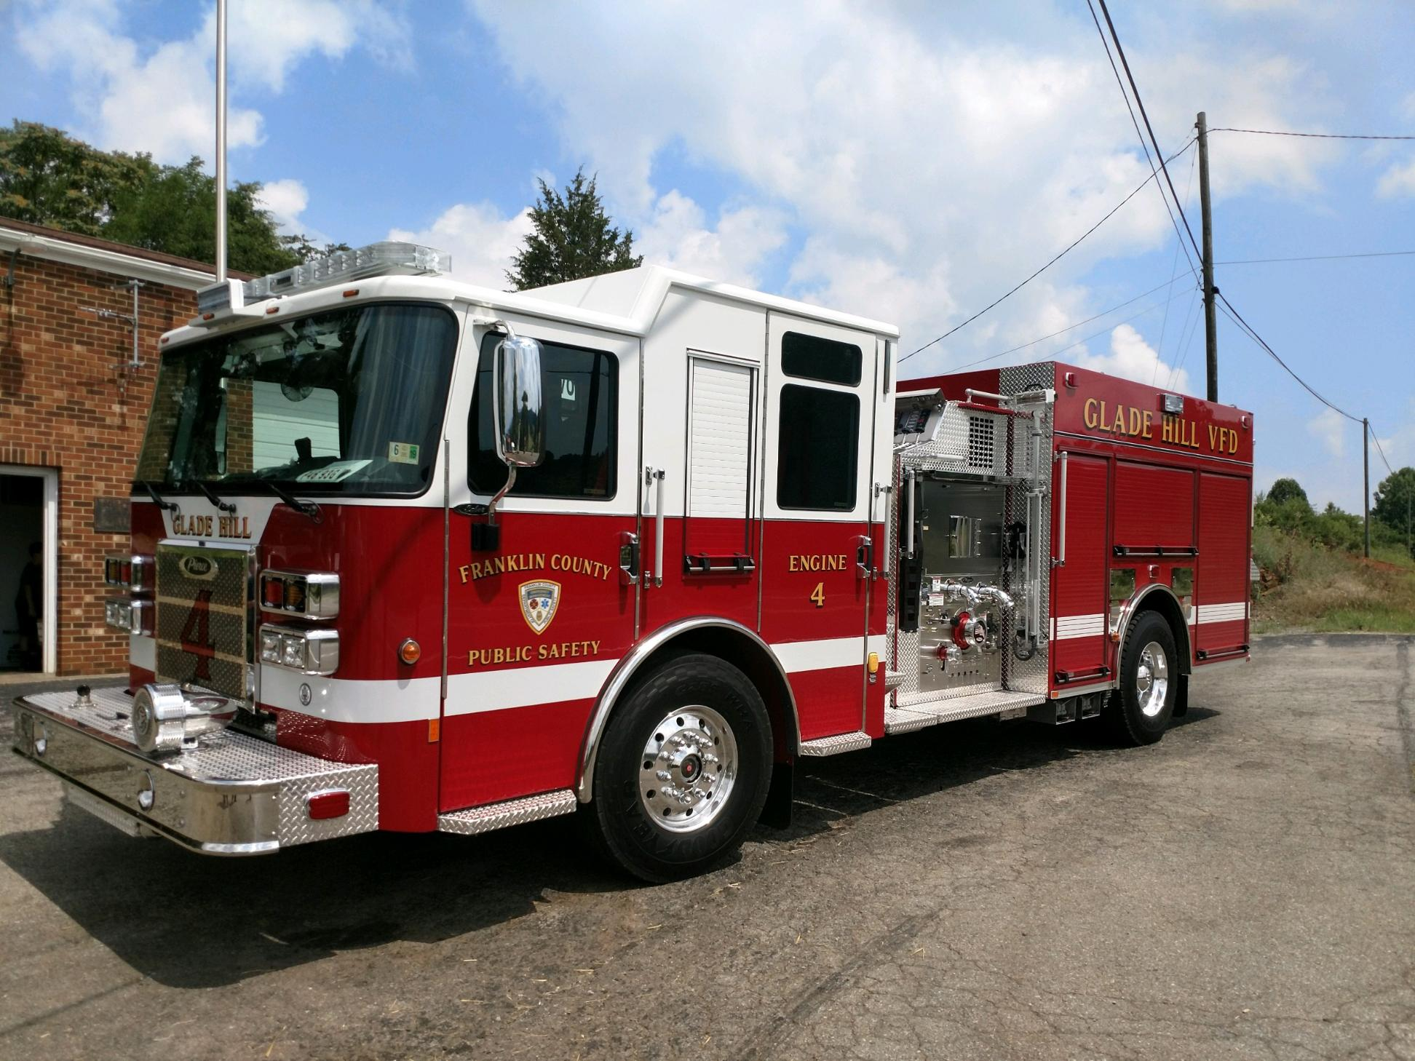
Fire Apparatus Replacement Program
Callaway VFD Tanker Was Recommended Based On Both Methods
Current Quote (11/21/22) Of $451,842. ($466,842.00) Quote Expires 1/21/2023
$5,100.00 Prepay Discount If Prepaid When Ordered
Anticipated Delivery Date 565 Days After Order
Callaway VFD Membership Has Approved This Vehicle
Respectfully Recommend Moving Forward With Callaway VFD Tanker In Upcoming Budget
Notes:
Add $15,000 TO this Cost

Slide 11
“Pilot” Maintenance Program
Board Asked Staff To Explore Providing More Maintenance Funding To Volunteers
Five (5) Years Of Maintenance Data Requested From Volunteer Fire/EMS Agencies
Average Compiled From Data Received
Initially “Pilot” Will Begin With “Seed” Money
Additional Funding Requested In Operations Budget ($135K)
Allows County To Begin Reimbursement For Expenses Incurred By Volunteer Agencies
Recommend A Funding “Cap” Be Placed On Each Department As Part Of “Pilot” Program
Allows For Collection Of Long-Term Maintenance Data For Fleet Management
Development Of Routine Maintenance MAY Extend Life Of Apparatus
Consider Pre-Approved Repair Facilities Determined In Collaboration With Volunteer Leadership
Example: Liability Insurance, Capabilities, Etc.

Slide 12
Volunteer Grant Program
$50,000 Of One-Time Funds Have Been Budgeted
Staff Developed “Draft” Application Process
“Draft” Provided To Volunteer Fire Association In Summer
“Draft” (V.2) Returned By Volunteer Fire Association With Changes
Reviewed By County Staff With Suggestions Noted
EMS Inclusion, Match Requirement, Reimbursement Based
This Program Could Fund Several Of The Requested Volunteer Capital Items
One (1) Application Has Been Submitted To Public Safety For This Program
Callaway VFD Requested $6,500 For Extrication Tool
Notes:
Staff Would Suggest Inclusion Of EMS. Staff Understood That Board Desire Was To Have A Match, Is That Still The Pleasure? If So What %?

Slide 13
Volunteer Funding Provided By Franklin County
Stipends
Assist With Equipment Purchase
Apparatus (Ambulance/Fire)
Provide Training
Fuel And Utilities
Unrestricted Funding
Insurance (Worker’s Comp, Building, Vehicle, LODA, Accident/Sickness )
Volunteer Grant Program
Additional Apparatus Maintenance Funding????
Notes:
Career Staff do not have accident and sickness coverage—Eric Newman Story

Slide 14
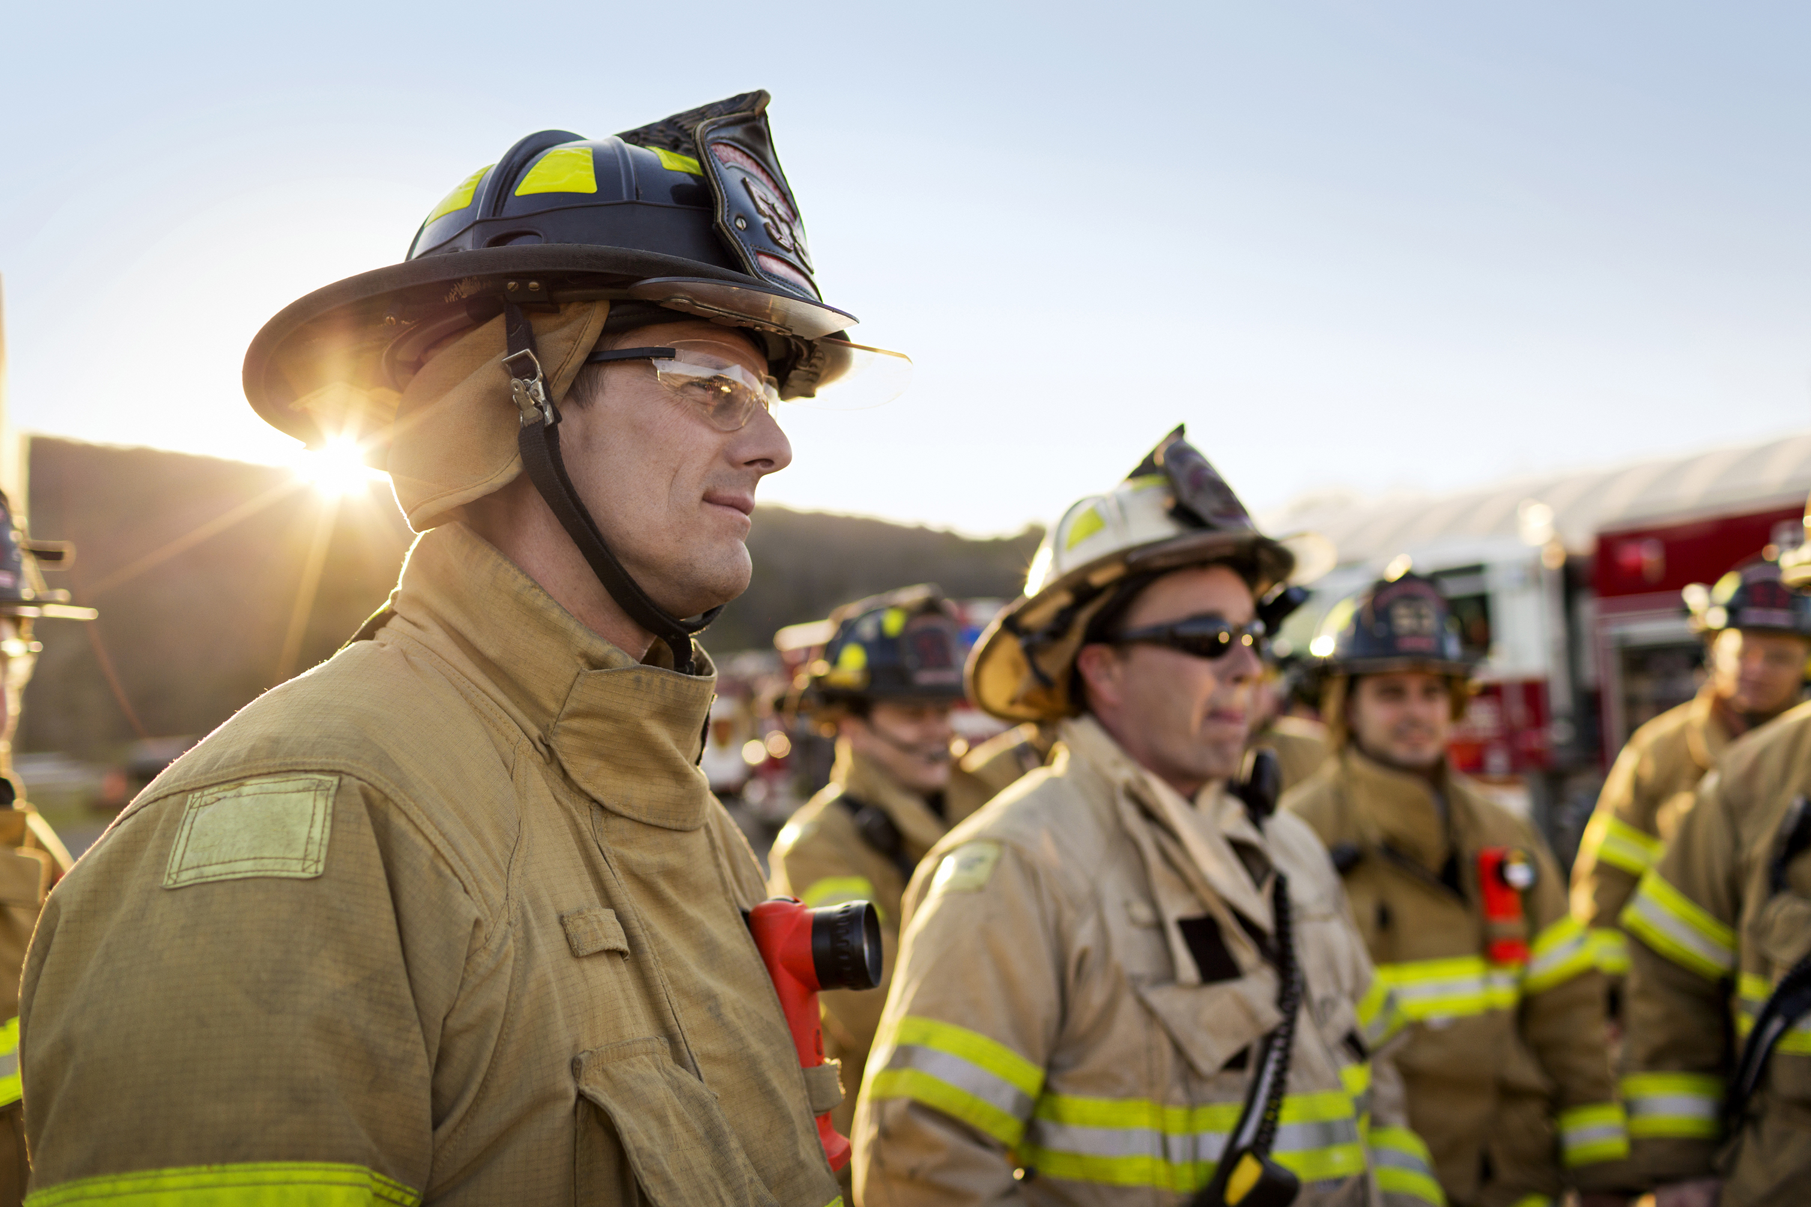

Questions/Comments
Notes:
Ask For Questions/Comments

Slide 15
Work Session Topics
Review of Previous Work session
Apparatus Replacement Formula
Apparatus Maintenance
Volunteer Grant Program
FY 23-24 Budget Work session
Capital Budget
Operating Budget
Potential Revenue

Slide 16
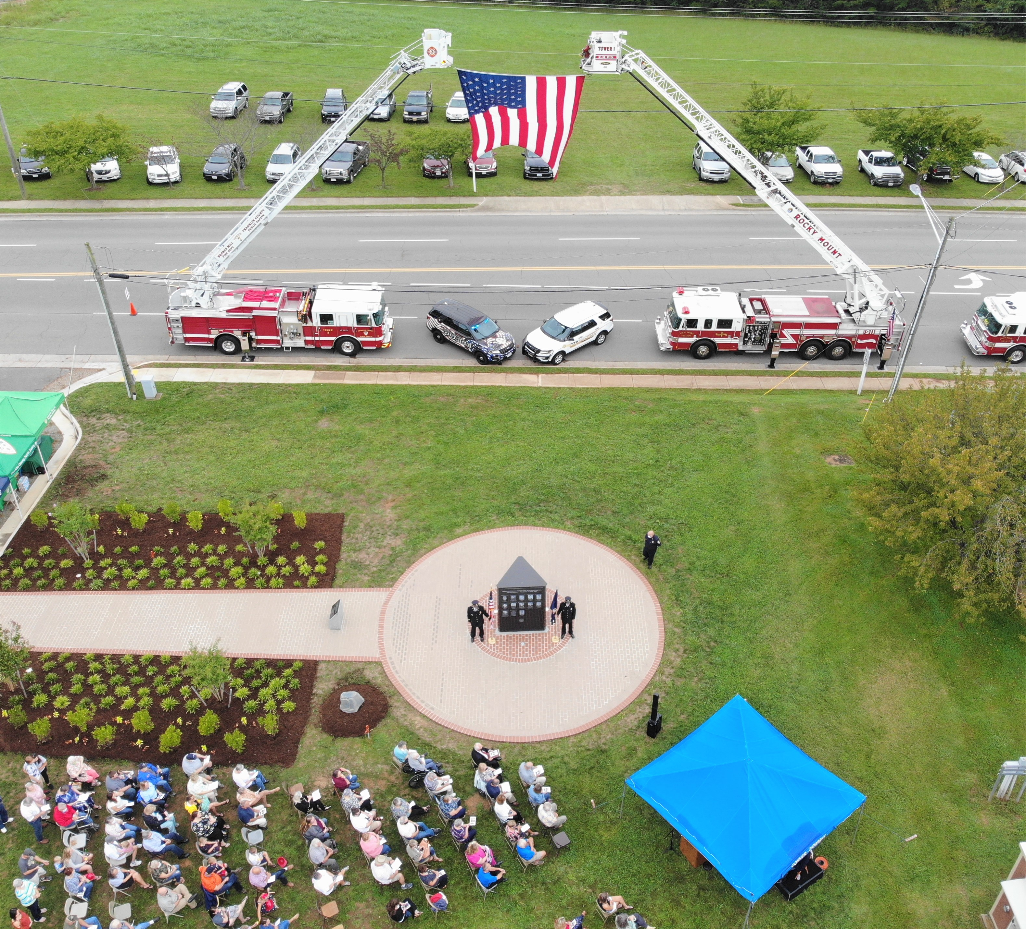
Daily Fire/EMS Field Staffing Levels
1 Operations Captain 24/7/365
1 Operations Lieutenant 24/7/365
2 Providers 24/7/365
Boones Mill Fire Department
Ferrum Rescue Squad
Fork Mountain Rescue Squad
Franklin County Rescue Squad
Glade Hill Rescue Squad
Westlake Fire/EMS
1 Provider 12/7/365
Snow Creek Rescue Squad
Notes:
On 1/12/2023 All Units were on calls between 10:30-11:30 and another call had to wait 34 minutes for ambulance for Chest/Dyspnea. 1/13/23 Dumped at 11:46 for 7 minutes.

Slide 17
EMS Call Trends
15% Increase Pre-COVID Vs. Post COVID (2019-2022)
Notes:
Consider

Slide 18
EMS Response Time Trends
National Standard 6-8 Minutes
Notes:
AHA Less than 6 Minutes to Get Heart Beat. Mention Recent NFL Example

Slide 19
Fire Call Trends
Proactive Fire Prevention Activities
Notes:
Decrease In Fire Responses May be attributed to increase in Fire Prevention Activates, Outreach Education.

Slide 20
Fire Response Times
Notes:
Does NOT paint a true picture (EXPLAIN)

Slide 21


Public Safety Capital Budget Needs/Pressures

Slide 22
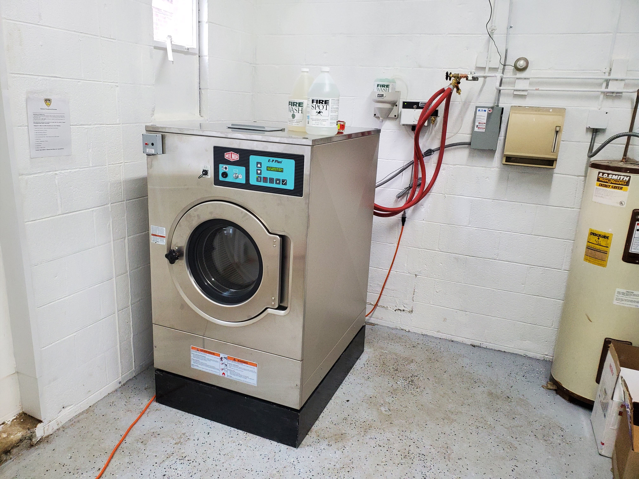
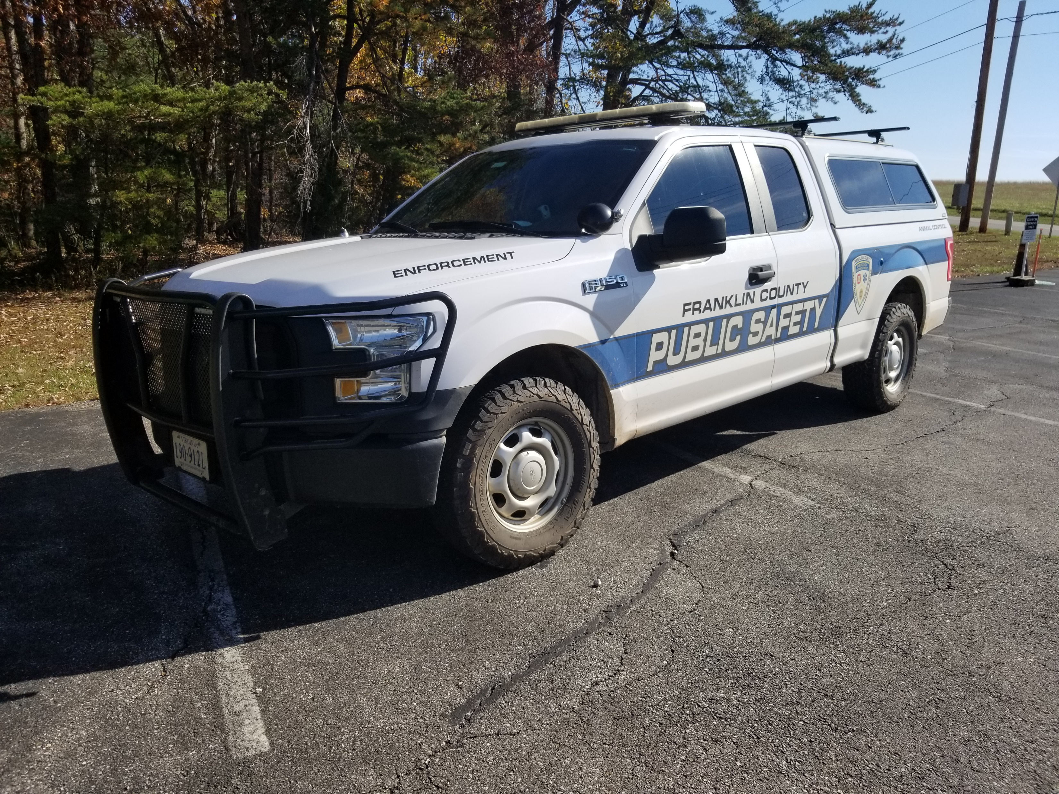
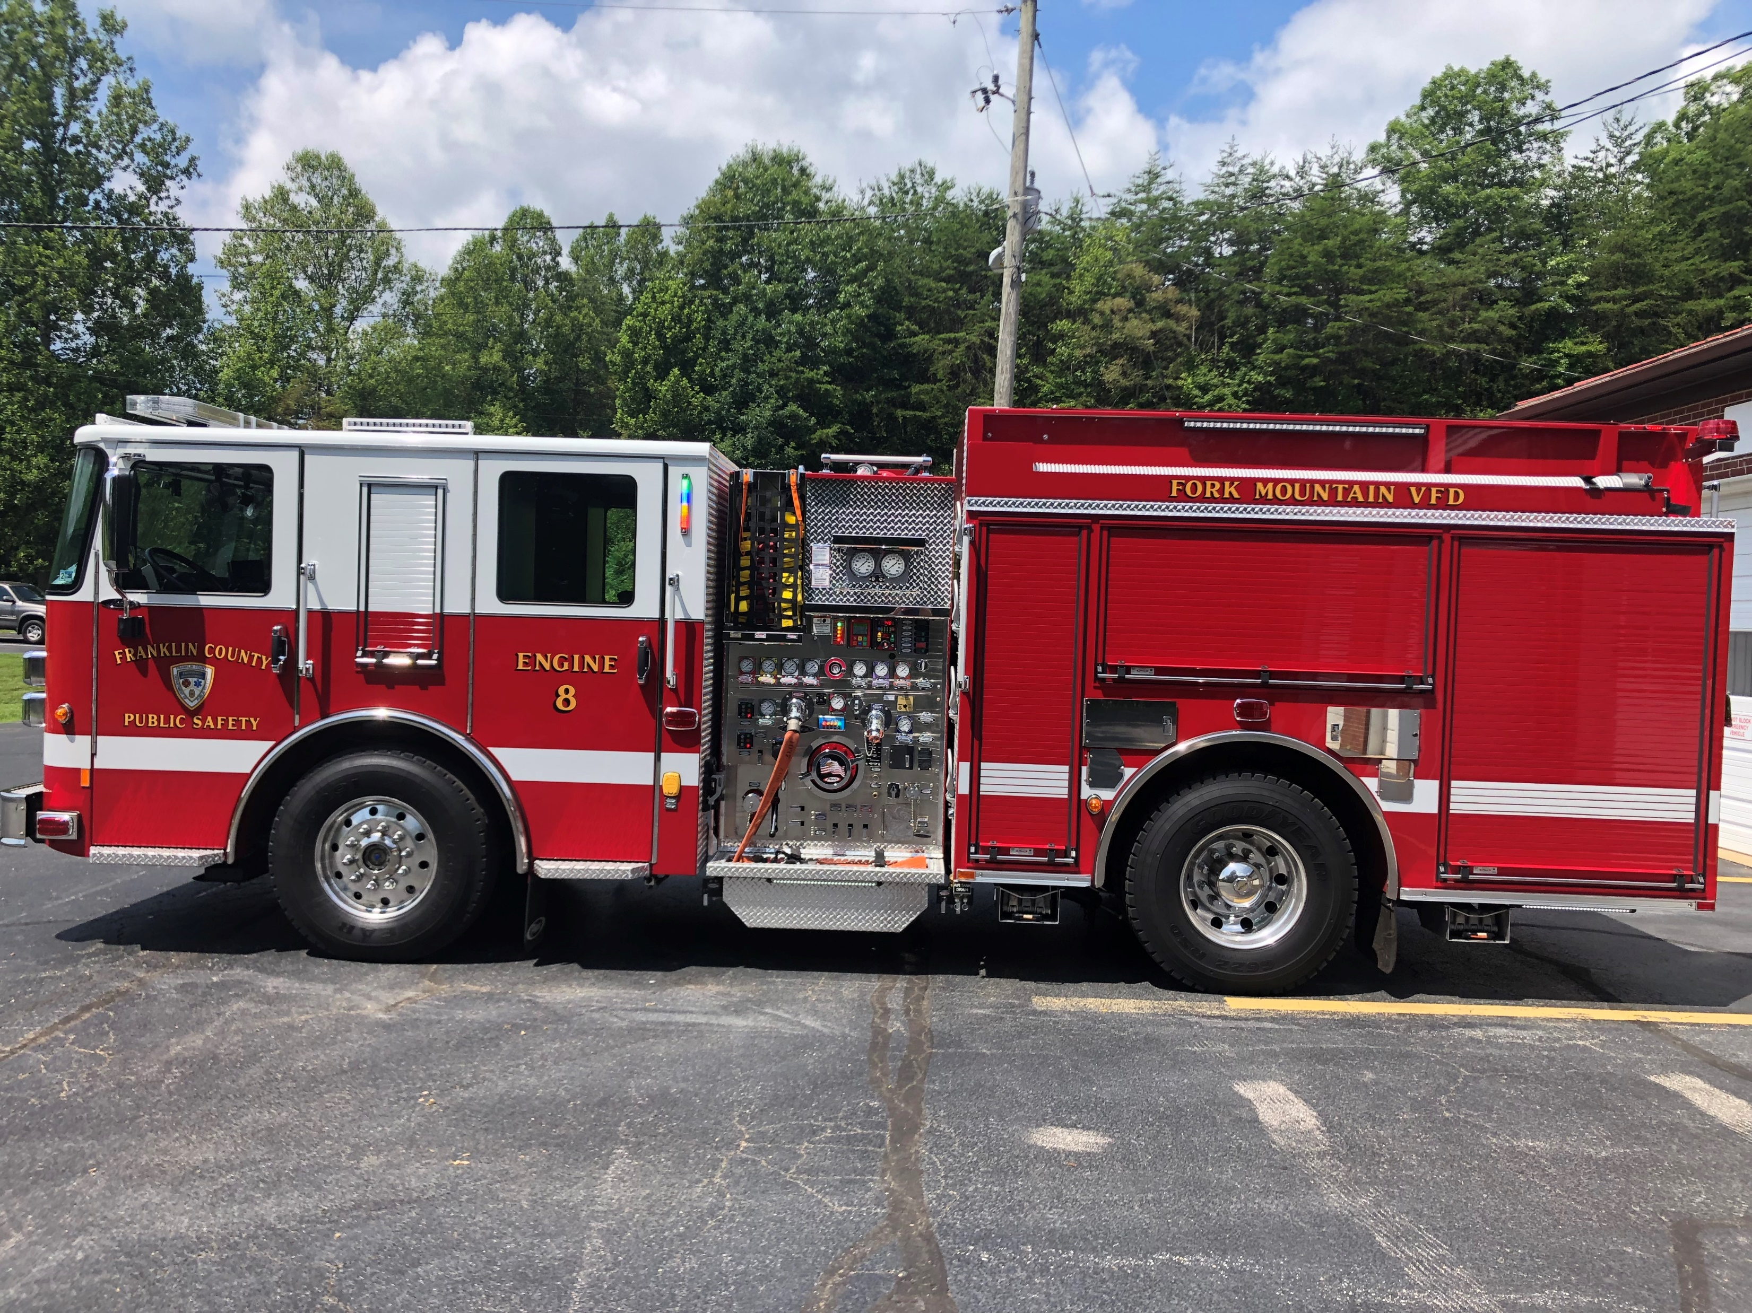
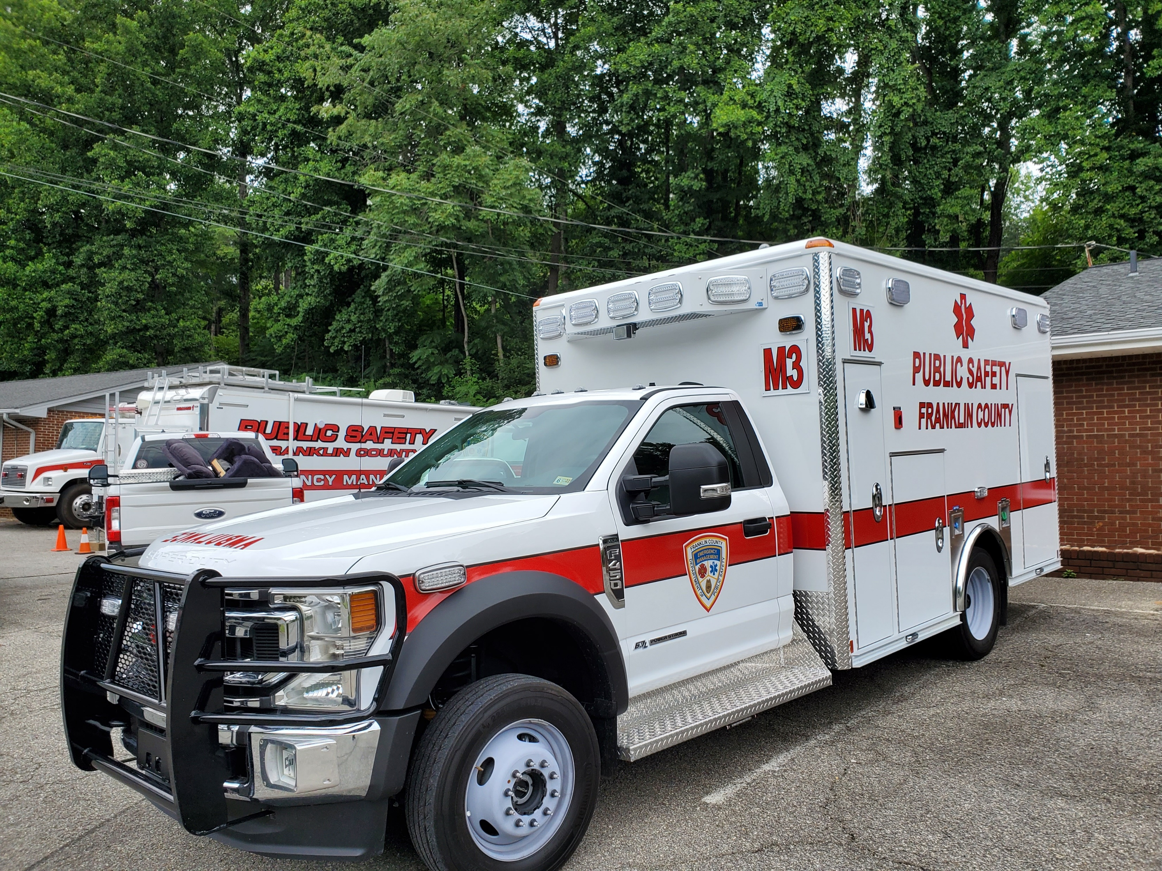
Public Safety Capital Needs/Pressures
Ongoing Leases
Ambulances
Fire Apparatus
Fire/EMS Equipment – AED, Etc.
Radio System
End Of Life Radios – 900+
Upgrades/Repairs
Increased System Maintenance Costs
Facilities
Notes:
Currently 95% Of Our Radios has or will reach End-Of-Life in 2 years. Explain End-Of-Life

Slide 23

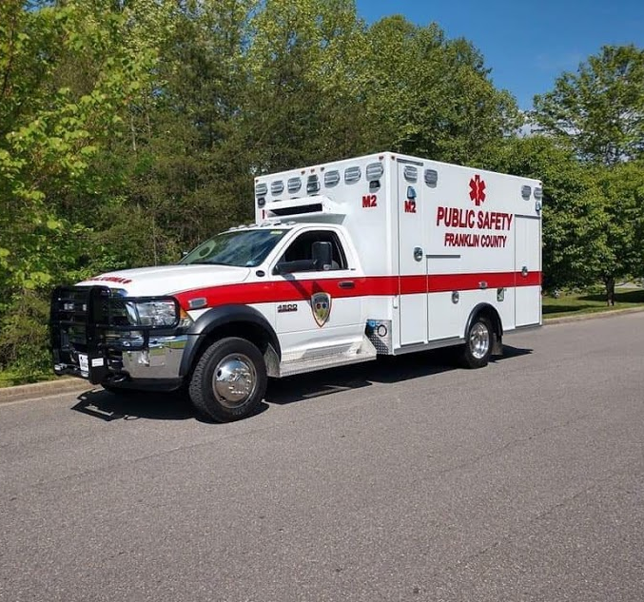
Increasing Apparatus Costs
Ambulance - $238K In 2020 Vs. $388K
Fire Engine - $475K In 2018 Vs. $850K
Quint-Ladder – 2018 $962K Vs. $1.6 Million
Tanker - $620K
Urban Interface - $400K
Brush Truck - $100K
Notes:
Tanker at Burnt Chimney would be 750-800K today. Brush truck is F250 with 200 Gal. Tank. Glade Hill & Fork Mountain Engines Were $475K

Slide 24
Ambulance Replacement Plan
Purchased (Financed) 3 “Wheel Coach” Units August 2020 At $236,057/Unit
Currently Have 1 “Stock” Unit On Order
$295,000
Money Already In Budget
Delivery March/April 2023
Current Delivery On Custom Units Is 900-965 Days
Notes:
Stock Unit Is Demers.

Slide 25
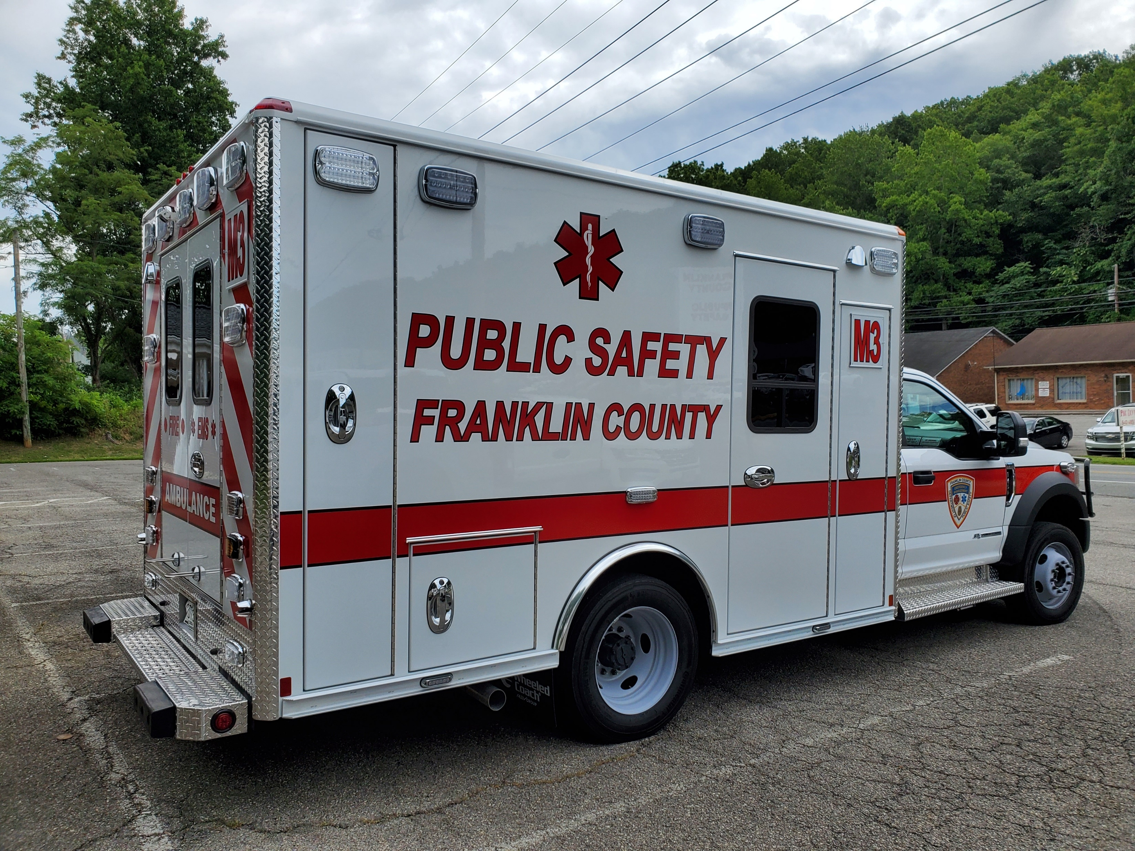
Ambulance Replacement Plan
2 Ambulances Currently In System Have Low Mileage (~3,000/~30,000 Miles)
Implementation Of Vehicle Rotations Based Mileage/Call Volumes
Have Began Dialogue With 2 Volunteer Agencies---Some Questions From Agencies
Concern From Volunteers That We Will Be Placing Vehicles With Issues In Their Stations
Feel This Can Be Resolved By County Picking Up The Maintenance
Potential Cost Saving From Consistently Maintaining Apparatus
Staff Is Planning To Move Forward With Rotation Of Ambulances

Slide 26
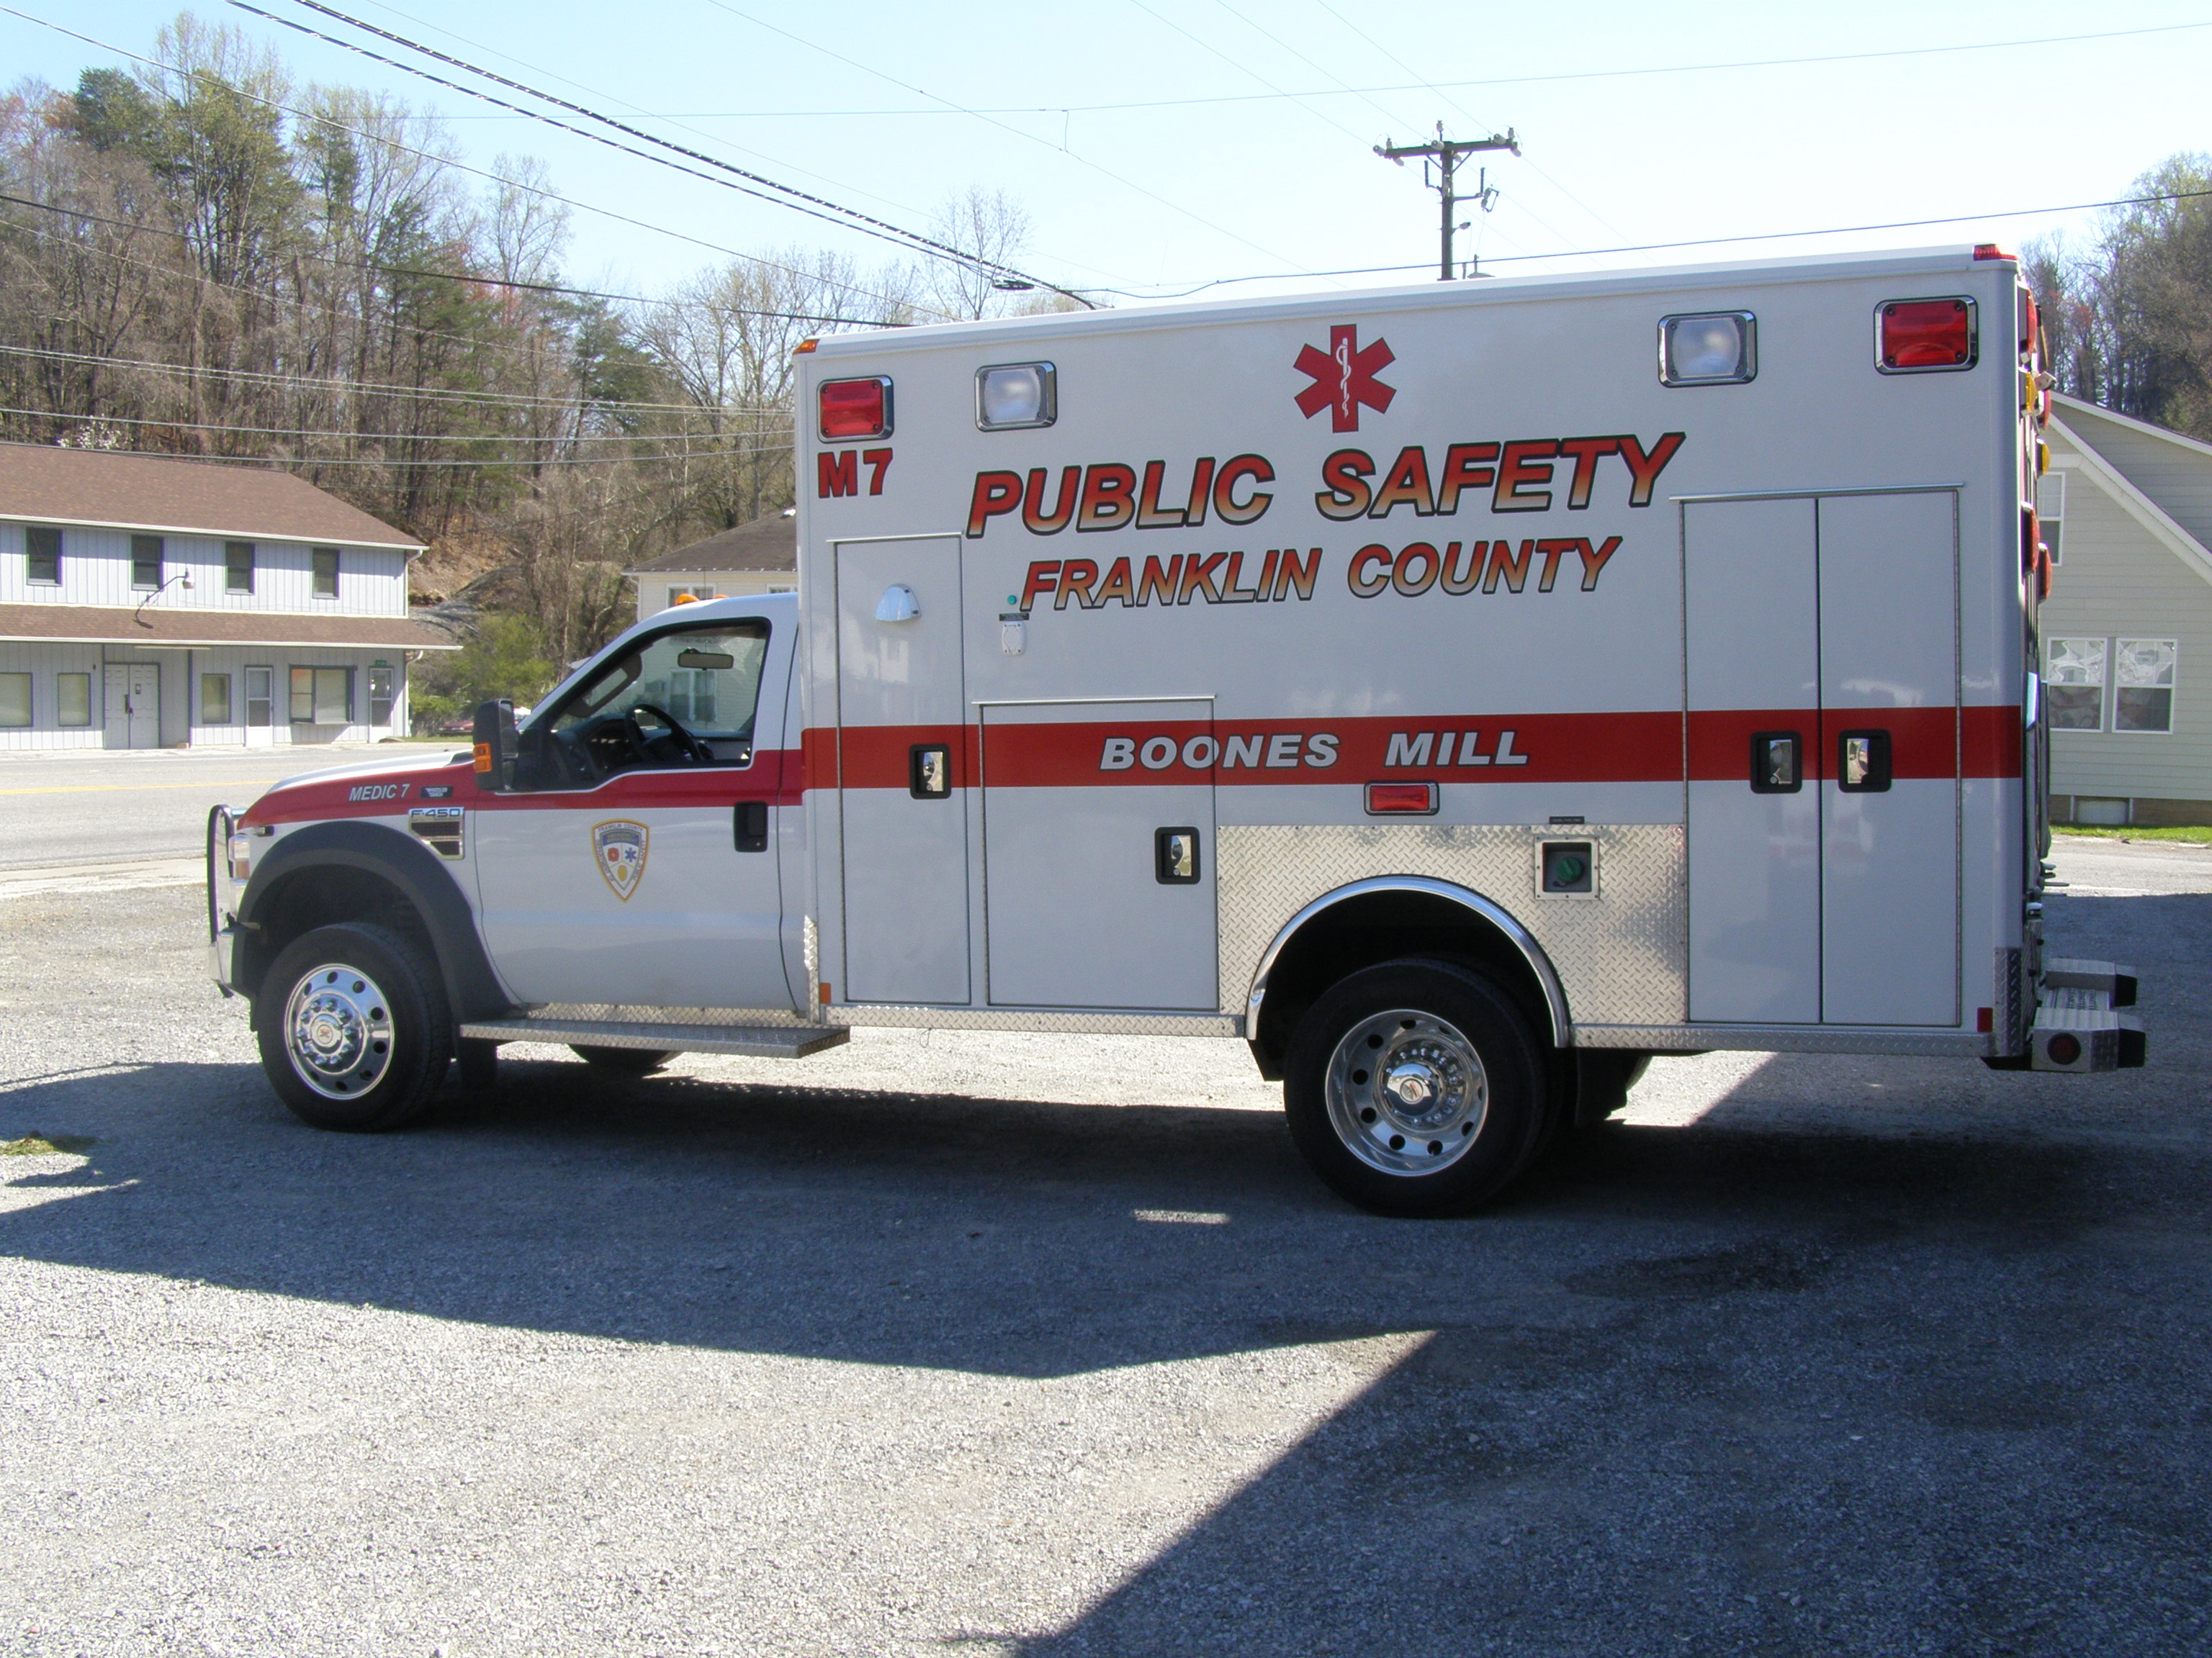
Ambulance Replacement Plan
In Need Of 3 New Units In Next Two-Three Years
Cost Today ($346K-$388K)---One Vendor Has Experienced $40K Increase In Last 4 Months
Delivery 900-965 Days
Can Be Paid For On Delivery (Down Payment Required At Order)
Current Ambulance Leases Are Paid Off In 2025
Staff Respectfully Request Permission To Place Order ASAP Due To Extended Delivery Dates & To Avoid Additional Price Increase.
Most Ambulances Are Replaced Due To Mechanical Issues As A Result Of High Mileage
Explore Replacement Of Engines On Some Units. ($12,000)
Current Reserve Funding To Assist
Possibly Extend Life Of Apparatus

Slide 27

Current Leases
Vehicle | Date Funded | Amount | Payoff Year | Other
Ambulances | 11/2020 | $183K | 2025 | CIP
Ladder 10 | 12/2017 | $112K | 2027 | CIP
Ladder 7/Engine 8 | 2/2018 | $175K | 2028 | Aid-To-Locality Funds

Slide 28
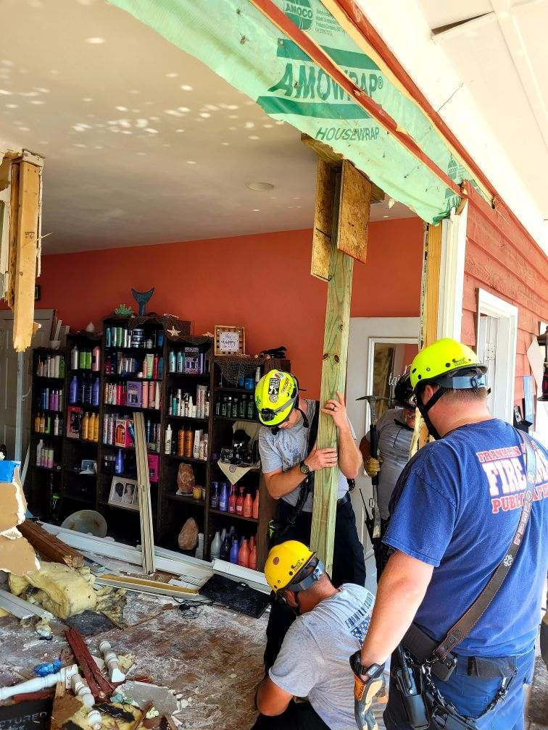
Volunteer Capital Requests
FVFD $44,000 Requested Extrication Equip.
BMVFD $9,530,500 Requested Station/QRV
SCVRS $186,000 Requested Building Modifications
CVFD $6,500 Requested Extrication Equip.
FMVFD $21,101 Requested Bldg. Modification/Pagers
RVRS $157,000 Requested Bldg. Modification/Pagers

Slide 29
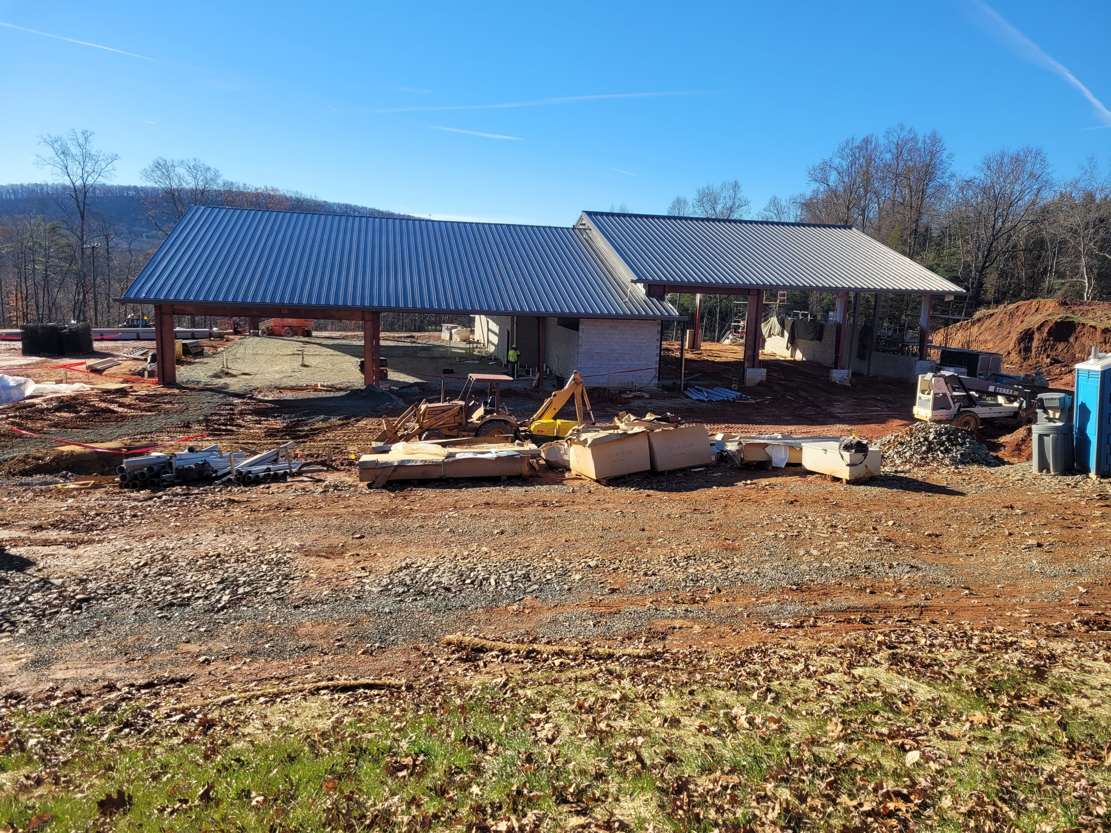
Station/Facility Needs
“Space Needs” Facilities Study Currently Being Conducted By General Properties
Public Safety Administration Offices – $52,920/Annually
Westlake--$57,034/Annually.
Consider Purchase Of Site/Building Rather Than Continuing To Lease
911 Center Needs To Be Upgraded
Emergency Operations Center (EOC)==Tremendously Outgrown Facility
Public Safety Storage Building/Area – Vehicles & Equipment --- MCP/SWT/SOT/Reserve Apparatus. ($350K Outside)
Potential New Station In Hardy Area and The 220 Corridor

Slide 30

Public Safety Operational Budget Needs/Pressures
Staffing – ACO, Field Staff, Logistics, Radio Technician, EMS Training
Fuel, Utilities, Insurance Increases
Equipment Needs – Cardiac Monitors, Turn-Out Gear, Etc.
Radio System Maintenance
Fire Prevention – Inspections, Investigations, Outreach Education
Maintenance Needs

Slide 31
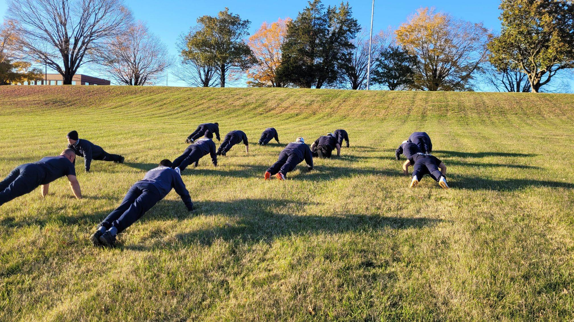
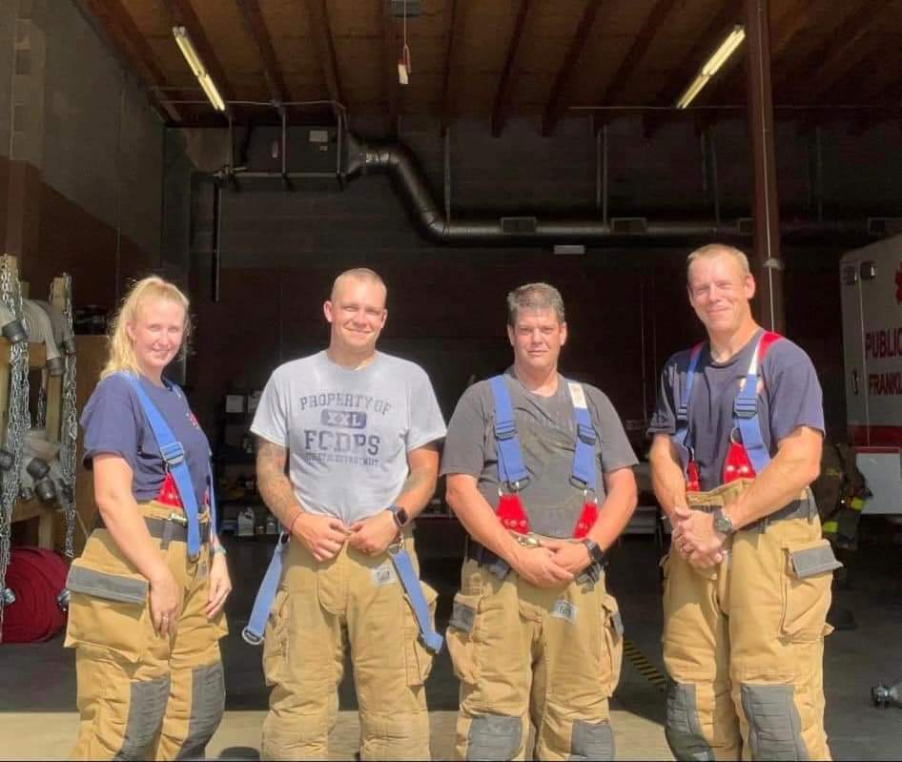
Requested Positions
Animal Control Officer
Paramedic/Firefighter (3)
Logistics Officer
EMS Education/Quality Management
Future Position Needs
Deputy Emergency Manager
Inspectors/Investigators
Division Chief EMS
Division Chief Fire

Slide 32
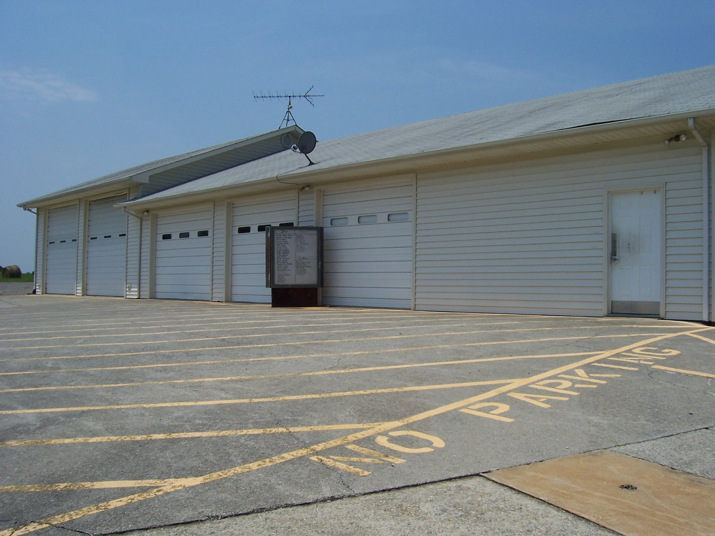
Snow Creek Coverage
CY 2022 (262 Calls Or .7 Calls/Day)
Currently Provided Coverage Through One (1) Provider 12/7/365
Currently Two (2) FTE Funded For This Station (Rotation)
Snow Creek Rescue Squad Is Not Active
Answered 2 Calls With Volunteer Staffed Unit In CY 2022
12/7/365 Coverage With Staffed Ambulance Requires Additional 2 FTE ($162K)
24/7/365 Coverage With Staffed Ambulance, Requires Additional 4 FTE ($324K)**
Four (4) Additional FTE Allows For 24/7/365 Coverage. Requires Modifications Be Made To The SCRS Facility. This Would Require An Investment Of $324K (4 FTE) And $186K (Updated Estimate Needed) For Facility Upfit For A Total Of $510K
Notes:
Compared To Squad 2 FCRS at 8.2 Calls/Day, basically one call every 3 hours. Average call 2.5-3 hours.

Slide 33

Volunteer Operations Request
SVFD $5,860.13 Requested Hose Testing/Various Small Items
BCVFD $25,155.98 Requested Hose/SCBA Testing HVFD $2,977.24 Requested Upgrade Lights
BMVFD $5,861.70 Requested Hose Testing/Various Small Items

Slide 34
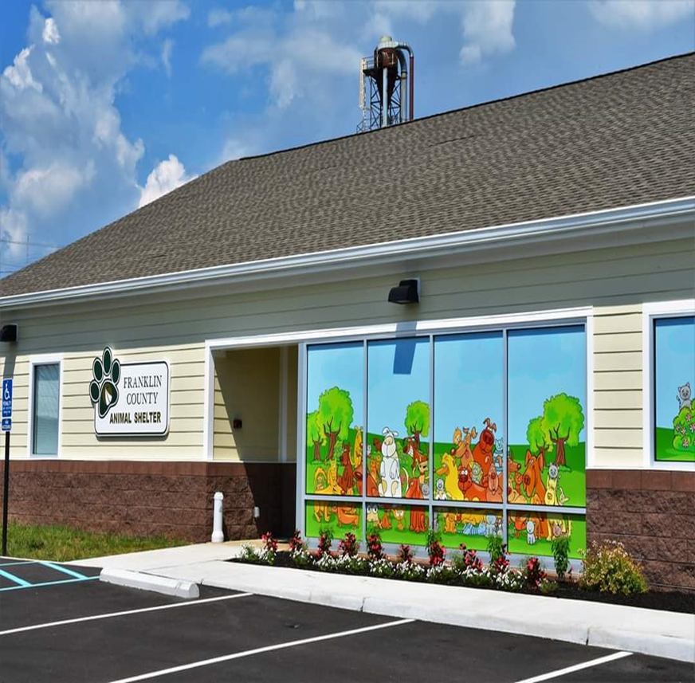
Animal Control Operations
 | CY 2019 | CY 2020 | CY 2021 | CY 2022
Animal Intake | 631 | 616 | 680 | 960
Summons/Conviction | 55/49 | 29/29 | 189/101 | 159/44
Hours Worked Including OT | 3,503 | 3,537 | 3,292 | 3,698
Mileage Driven | 43,034 | 36,264 | 38,130 | 48,594
Calls | 2,591 | 1,672 | 2,076 | 2,512
Officers | 2 | 2 | 2 | 2
Notes:
Stress Need For Additional Officer. Increased Hours, Decrease In OT (30-40 Hours down to 5-7) & Citizen Concerns, Improved Customer Service

Slide 35

Revenue Opportunities
No Funding From The “General Fund” Provided By The “Commonwealth Of Virginia” For Fire/EMS/Emergency Management. Only Pass Thru Funds. Excellent Opportunity To Speak With Our Legislatures!!
Aid-To-Localities/Return-To-Localities (ATL/RTL)---Based On Fire Insurance---Can Only Be Utilized For Fire Needs. Currently Dedicated For Fire Apparatus.
4-For-Life---Based On Car Registrations---EMS Needs---Currently Dedicated To EMS Training
Building Resilient Infrastructure And Communities (BRIC)---Grant Outstanding.
Grant Opportunities
Hazard Mitigation Grant Program (HMGP)
Radio Upgrades In Boones Mill ($2.5M)---Grant Pending
Assistance To Firefighters Grant (AFG)
Equipment (500K)---Grant Pending
Staffing For Adequate Fire And Emergency Response (SAFER)
Personnel---Grant Pending

Slide 36

Revenue Opportunities
Implementation Of Tax Levies
§15.2-2403 and §27-23.1
Stafford County, Prince William County, Manassas
Revisit Meals Tax Adjustment
Revisit Cigarette Tax
Real Estate Tax Increase (.01 = $700K/Annually)
Opioid Settlement Funds (Limited Use Of Funds)

Slide 37

Revenue Opportunities
Strengthen EMS Revenue Recovery Process---$672,454 Uncollected
Rescue Squad Assistance Funding---Twice-A-Year---Competitive Process
Permit Fees
Inspections/Plan Reviews
Fire Works/Explosives
Henry, Roanoke, Staunton, Stafford, Albemarle,
Danville
Amusement Building $75.00/Annually
Assembly (Excludes Church's & Non-Profits) $75.00/Annually
Blasting (30 Day Permit/Site) $75.00
Commercial Burning (30 Day/Site) $75.00/Annually
Explosive/Blasting Storage (Per Magazine) $75.00/Annually
Aerial Display Fireworks $75.00/Day/Site
Firework Sales $75.00/Annually
Hazardous Materials $75.00/Annually

Slide 38
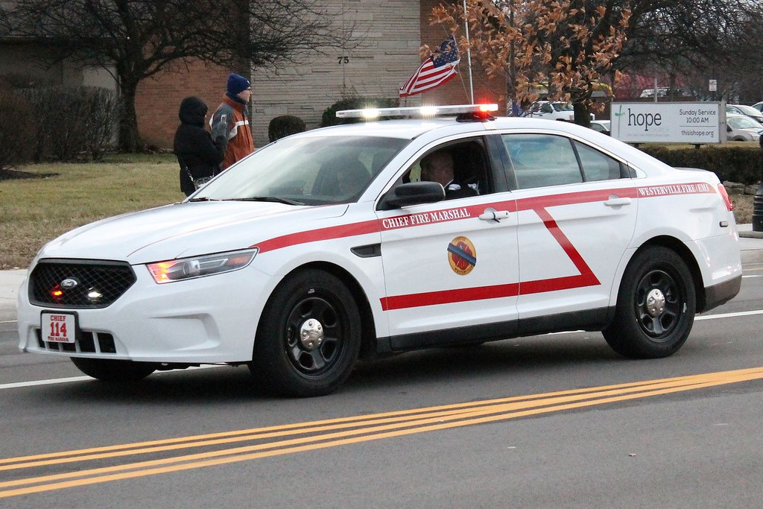
Revenue Opportunities
LP Gas (Fill Station) $75.00/Annually
Mobile Food Truck $75.00/Annually
Social Service License $75.00/Annually
Tire Storage/Byproducts $75.00/Annually
Routine Fire Inspection $0
First Follow-Up Inspection $0
Subsequent Follow-Up $75.00

Slide 39
Revenue Opportunities
Item | Current Fee (1988) | Proposed Fee
Hazardous Materials Response (Apparatus/Sec. 8-81) | $75.00/Hour/Apparatus | $200.00/Hour/Apparatus
Hazardous Materials Response (Person Hours/Sec. 8-81) | $10.00/Hour/Person | $35.00/Hour/Person
Negligent/Unlawful Acts (Apparatus/Sec. 8-82) | $75.00/Hour/Apparatus | $200.00/Hour/Apparatus
Negligent/Unlawful Acts (Person Hours/Sec. 8-82) | $10.00/Hour/Person | $35.00/Hour/Person
False Fire Alarms (After 2/Year) | $75.00/Alarm (After 2/Year) | $75.00 + $25.00 Escalating
Notes:
Would Require A Public Hearing

Slide 40
Revenue Opportunities
Item | Current Fee | Proposed Fee
Dog Adoption | $40.00/Animal | $50.00/Animal
Cat Adoption | $20.00/Animal | $25.00/Animal
Intake Fee | $30.00/Animal | $35.00/Animal
Boarding Fee | $12.00/Day/Animal | $15.00/Day/Animal
Owner Surrender | $0 | $25.00/Animal
Public Service EMS Response Fee | $0 | $100.00/Response
Notes:
Explain What These Fees Are For

Slide 41

Immediate Priorities
Priority 1 Three Ambulances ($1,038,000) *1/10/2023
Priority 2 Animal Control Officer ($126,823 Including Vehicle)
Priority 3 Logistics Staff Member ($126,000)
Priority 4 Hiring Of 3 Additional Fire/EMS Staff ($243,355)
Priority 5 Callaway VFD Tanker ($500,000)
Priority 6 Increased Funding Of Vehicle Maintenance For Volunteers ($135,000)
Priority 7 Fire/EMS Equipment CIP ($348,000)
Priority 8 Radio Subscriber Replacement ($100,000)
Priority 9 Additional Communications Staff ($40,000)
Notes:
Maintenance funds are included in Operations Budget Request.

Slide 42
Questions/Comments

